Slide 1
Project:
“Green Agenda for Georgia”
EU4Environment National Conference
November 2023
Notes:
Image: Unsplash (no credit required). https://unsplash.com/photos/H5g9j6HeHck

Slide 3
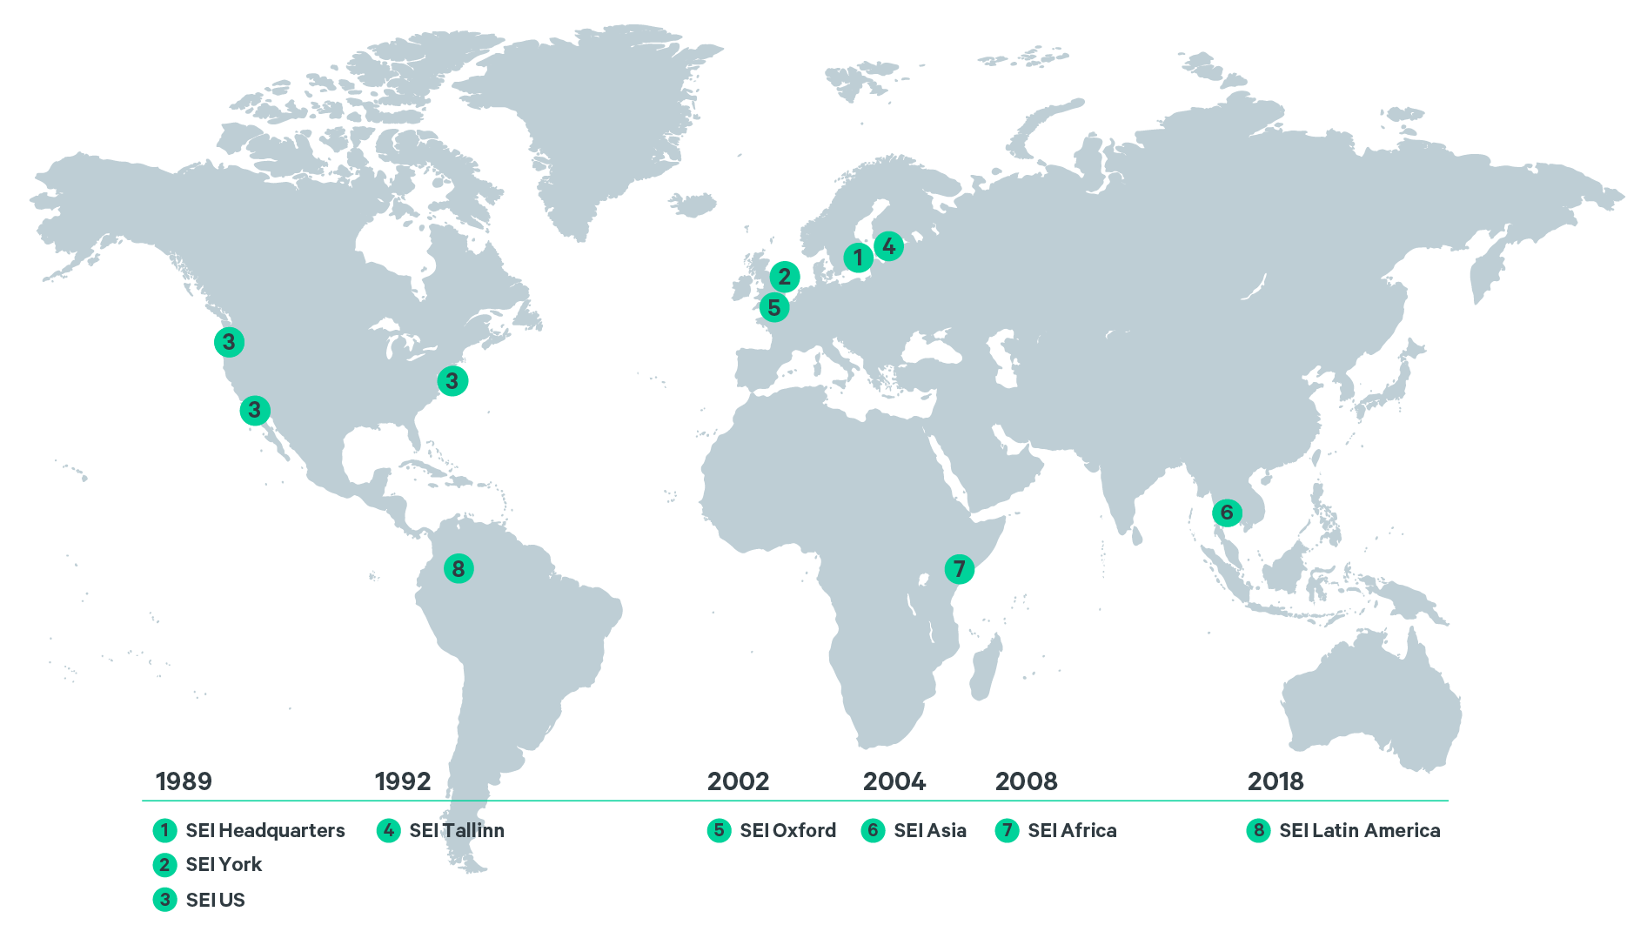
SEI centers: Grounded in Context
Notes:
SEI's distributed structure captures much of what makes SEI effective and is a founding element of our delivery model and identity.
Our centres ground us in local realities, ensure that we are responding to the right agendas, and create opportunities for partnerships and long-term engagement. We aim to add value to regional research, policy and practice, including by connecting to the worldwide research community and conducting comparative research between regions. We recruit staff with deep expertise in the regions where our centres are based and contribute actively to local and regional capacity development.
The centres are located on five continents, in Latin America, East Africa, North America (US), Western and Central-Eastern Europe and Southeast Asia. This unique centre structure also enables North-South, South-South and South-North learning. Crucially, the work of the centres builds on and connects to SEI’s expertise globally.
While our centres act as regional anchors, SEI is active across all the main continents of the world. Where we work is determined by the challenges faced, the partnerships that are viable, the demand for our work, and what added value SEI can bring.

Slide 4
Project Summary
Name
Green Agenda for Georgia, Ukraine, Moldova and Armenia
Timeline
3 years (2023-2026)
Owners
Administration of Georgian Government and Key Relevant Ministries
Lead
SEI HQ
(including SEI Tallinn), IUCN
Swedish International Development Cooperation Agency (SIDA)
Donor
Budget

Slide 5
The GA GUMA project objectives
The primary objective of the project:
To assist Georgia in reaching climate neutrality goals through the green transition
The specific objectives:
To enhance Georgia’s policy alignment with the EU through the EGD lens and identify further alignment needs and opportunities
Provide technical support in the EU integration/accession process where relevant
Contribute to raising public awareness about green transition, its urgency, and possible benefits
Enhance the capacity of key stakeholders in order to empower Green Transition

Slide 6
Project Focus
Regional connections, opportunities and linkages
Regional
National
National issues, stakeholders, priorities, context and speed

Slide 7
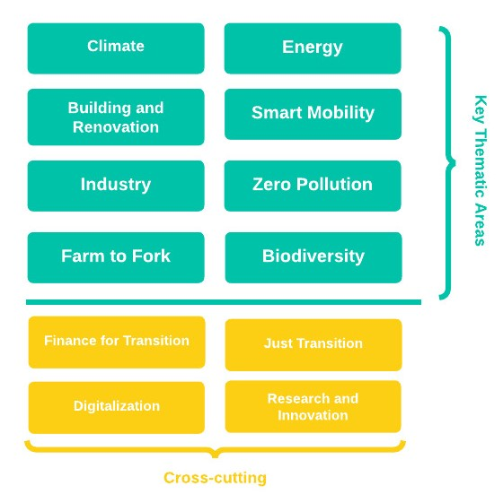
Thematic Areas covering the assessment of EGD

Slide 8
Key project deliverables
Priority project proposal preparation
Jul 2025 – Mar 2026
Georgia's Climate Neutrality Roadmap 2050
Capacity building and technical assistance
Comprehensive Green Transition Assessment
Jul 2025 – Mar 2026
Sep 2023 – Jun 2024
Jul 2024 – Jun 2025
Voluntary regional or national Declaration
Jul 2025 – Mar 2026

Slide 9
Comprehensive Green Transition Assessment
Objectives
Scope
Outputs
Key indicators and trend analysis
Thematic area stakeholder mapping
Governance gap analysis:
Legal, Policy, Institutions, HR and capacity
Smart Policy mix analysis
Current and upcoming EU obligations (AA/pre-accession/accession)
Alignment with EU Green Deal
Crosscutting areas:
Transitional Finances
Digitalization
Social impacts
R&D and innovation
Climate neutrality modelling
Public perception study
Georgia's National CGTA Report (Priorities and focus)
8 Thematic CGTA reports (including cross-sectoral themes)
4 cross-cutting reports
1 Regional CGTA report
To provide a comprehensive green transition gap analysis and thematic (sectoral)/ national recommendations
To provide the project team with the necessary information, data, and knowledge in order to conduct Roadmap preparations
Sep 2023 – Jun 2024

Slide 10
Thank You
bernardas.padegimas@sei.org

