Slide 1
The RECP Assessments in Demonstration Companies The results obtained from the application of RECP measures, the most common difficulties/challenges, and opportunities encountered
Konstantine Barjadze - RECP Expert

Slide 2
RECP Companies and Implementation Status
# | RECP Companies | Sector | RECP Assessment Provided | Advanced RECP Assessment Provided | Suggested RECP Measures | Implemented RECP Measures | Plans to Implement RECP Measures | Implementation Percentage
1 | LTD "Teleti Poultry Factory" | Egg production | 1 | 1 | 3 | 0 | 1 | 0%
2 | LTD “Lagodekh Avtogza” | Asphalt production | 1 | 1 | 3 | 0 | N/A | 0%
3 | LTD "GIAM Group" | Fruit processing | 1 | 1 | 3 | 2 | 0 | 66%
4 | LTD "Geo-organic" | Fruit processing | 1 | 1 | 3 | 0 | N/A | 0%
5 | LTD "Tsivis Kveli" | Cheese production | 1 | 1 | 2 | 0 | 1 | 0%
6 | LTD "Nektari-2008" | Limonade production, Packaging industry | 1 | 1 | 2 | 1 | 1 | 33%
7 | LTD "Apeni Brewery" | Beer production |  | 1 | 1 | 1 | 0 | 100%
8 | Ltd "Trans Az" | Wood dryer factory |  | 1 | 1 | 0 | N/A | 0%
9 | LTD Liderplast | Plastic film production |  | 1 | 1 | 0 | N/A | 0%
10 | LTD Mixo's Gardens | Fruit processing |  | 1 | 1 | 0 | 1 | 0%
11 | LTD “Biodiesel Georgia” | Biodiesel production | 1 |  | 2 | 0 | 0 | 0%
12 | Vaziani Company LLC | Wine production | 1 |  | 1 | 1 | 0 | 100%
13 | Ltd "Chateau Mukuzani" | Wine production | 1 |  | 1 | 0 | 0 | 0%
14 | LTF “Titani” | Packaging industry | 1 |  | 2 | 0 | 0 | 0%
Total |  |  | 10 | 10 | 26 | 5 | 4 | 19%

Slide 3
RECP Assessment Results
Phase | No. of RECP options | Investment | Savings
 |  |  | Annual benefit | Energy | Water | Material | Waste | Emissions
 |  | Euro year | Euro/year | kWh/year | m³/year | tons/year | tons/year | CO₂eq tons/year
Recommended in the assessment report | 26 | 605 302 | 681 871 | 8 376 926 | 0 | 0 | 4 618 | 1 628
Implemented at the end of the monitoring period | 5 | 388 036 | 97 514 | 836 088 | 0 | 0 | 0 | 173
% of total achievement | 19% | 64% | 14% | 10% | 0% | 0% | 0% | 11%

Slide 4
The Key Issues and Barriers for SMEs to Implement EE/RECP Measure
Low level of understanding the real benefits of modern technologies;
Avoiding to be pioneers in introduction of new/modern technology (without demonstration of already successfully implemented similar measure);
High cost technologies with longer payback period(>5 years);
Lack of loan capacity (low potential of investment sources);
Lack of internal resources (for planning/testing and implementation the measure);
Lack of performance of waste management/recycling regulation;
Lack of performance of regulation about water treatment/waste water management;
Absence of emission taxes.

Slide 5
The Key Motivation Factors For SMEs to Implement EE/RECP Measure
Low investment cost
Comfortable funding source (adapted loan terms)
High energy saving potential
High resource/material saving potential
Short payback period
Long lifecycle of suggested technology
Guaranteed future maintenance support
Demonstration of already implemented similar RECP measure(s).

Slide 6
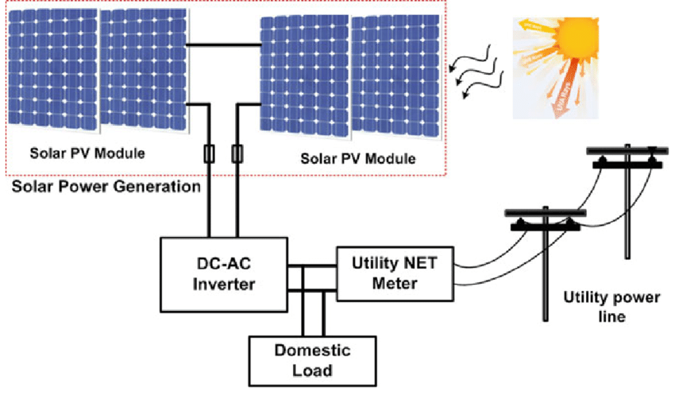
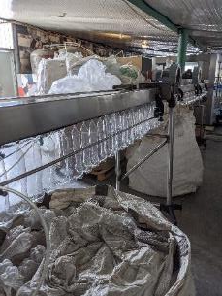
Sucssessful Example: Ltd. “Nektari”
Installation of On-grid Solar PV Station with Capacitiy 500 kWp

Slide 7
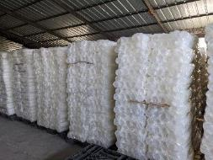
Ltd. “Nektari”
Results of implemented measure
Total investment cost | 1,200,000 | GEL
Annual financial saving | 214,400 | GEL
Simple payback period | 5.6 | Year
Annual energy saving | 670,000 | kWh/Year
CO₂ emmision reduction | 70 | Tons/Year

Slide 8
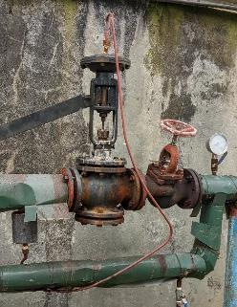
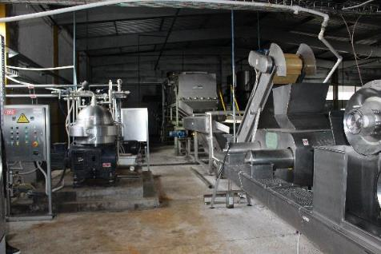
Citrus juice concentrate factory in Kobuleti Ltd. “GIAM Group”
RECP Measure #1: Installation of automatic pressure regulator in steam supply system for technological processes

Slide 9
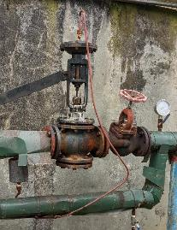
Ltd. "GIAM Group"
Results of implemented RECP Measure #1
Total Investment cost | 25,000 | GEL
Annual Financial saving | 71,539 | GEL
Simple payback period | 0.3 | Year
Annual Energy Saving | 502,848 | kWh/year
Annual Natural gas saving | 51,840 | m³/year
CO₂ emmision reduction | 102 | Tons/year

Slide 10
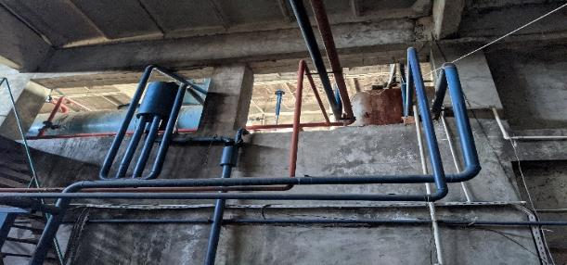
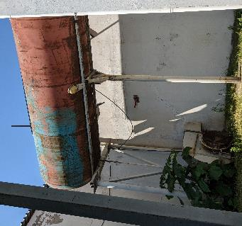
Ltd. "GIAM Group"
RECP Measure #2: Thermal Insulation of Condensate Tank and Pipes

Slide 11
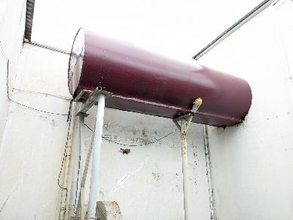
Ltd. "GIAM Group"
Results of implemented RECP Measure #2
Total Investment cost | 7,000 | GEL
Annual Financial saving | 59,460 | GEL
Simple payback period | 0.2 | Years
Annual Energy Saving | 344,265 | kWh/year
Annual Natural gas saving | 43,087 | m³/year
CO₂ emmision reduction | 69.5 | Tons/year

Slide 12
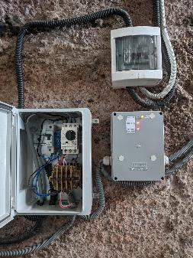
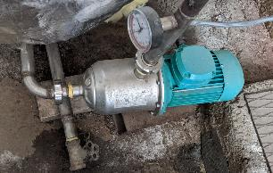
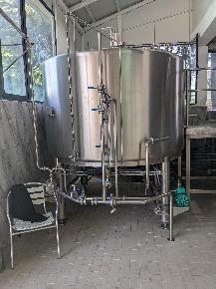
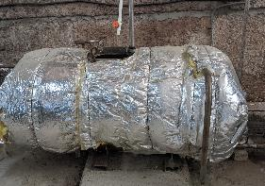
Ltd. "Apeni Brewery"
RECP Measure: Recirculation of Steam

Slide 13
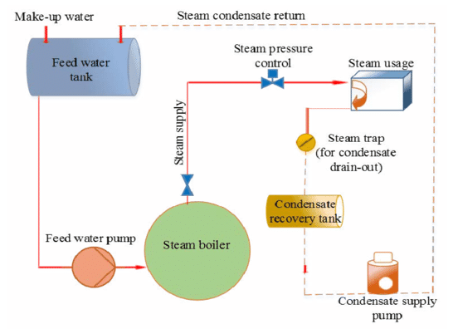
Ltd. "Apeni Brewery"
Results of implemented RECP Measure
Total Investment cost | 2,460 | GEL
Annual Financial saving | 8,655 | GEL
Simple payback period | 0.3 | Years
Annual Energy Saving | 66,164 | kWh/year
Annual Natural gas saving | 6,271 | m³/year
CO₂ emmision reduction | 12.3 | Tons/year

Slide 14
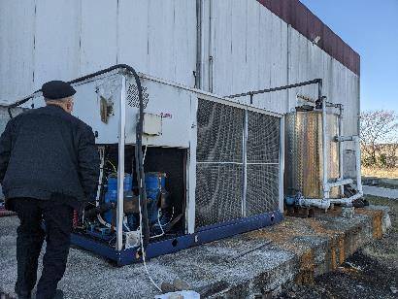
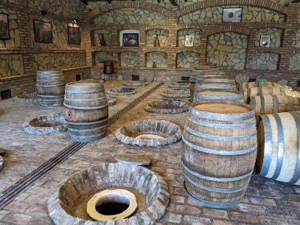
Ltd "Vaziani Winery"
RECP Measure: Replacement of old refrigerator with new one

Slide 15
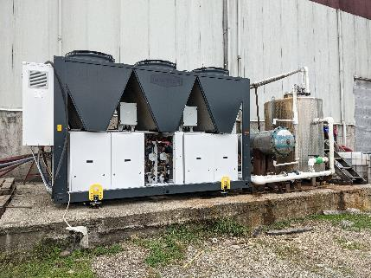
Ltd "Vaziani Winery"
Results of implemented RECP Measure
Total Investment cost | 216,000 | GEL
Annual Financial saving | 5,858 | GEL
Simple payback period | 26.6 | Years
Annual Energy Saving | 27,784 | kWh/year
CO₂ emmision reduction | 2.9 | Tons/year

Slide 16
Thank you for your attention!

