Slide 1

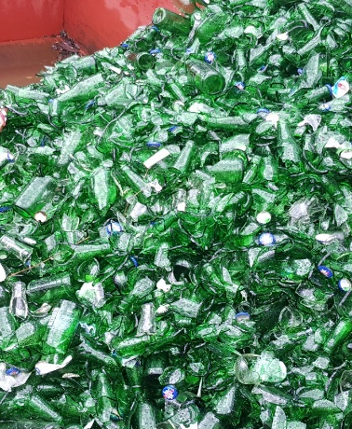
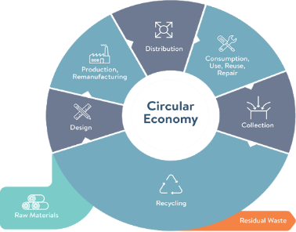
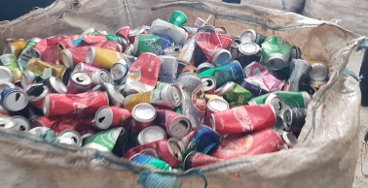

Support to Waste Management and Development of Circular Economy in Georgia: project presentation
Wim Van Breusegem,
Circular Economy Expert
National Conference: Will resource efficiency be at the core of the business success in Georgia?
Dates: 7-8 November 2023 / Venue: Hotel Biltmore Tbilisi
07 November 2023

Slide 2
This presentation
Support to Waste Management and Development of Circular Economy in Georgia
Project Objectives
Component 1: Policy framework for Waste Management
Component 2: Support to waste hierarchy, EPR and CE
Component 3: Development of IT systems/tools for waste
Component 4: Support to transition towards CE.
  The CE in Practice: a) Circular Design b) Direct reduction in resource use c) Recycling.
  Advancing the CE in Georgia: way-forward.

Slide 3
Project Objectives
Support to Waste Management and Development of Circular Economy in Georgia
General Objective
To improve protection of the environment as well as the health of the population in Georgia.
Specific Objectives
Outcome 1: Promote waste prevention and minimisation concepts to improve waste management practices.
Outcome 2: Support the introduction of the concept of “Circular Economy” in the society and the economic activities.

Slide 4
Component 1: Policy framework for waste management
Support to Waste Management and Development of Circular Economy in Georgia
Terms of Reference
Assess/update quantities of various waste; focus on municipal wastes, construction/demolition wastes, waste subject to management by extended producer responsibility (EPR).
Develop National Waste Prevention Programme (WPP).
Activities
Identify waste quantities.
Understand value-chains.
Prepare WPP strategy and action plan.

Slide 5
Component 1: Policy framework for waste management
Support to Waste Management and Development of Circular Economy in Georgia
Progress to Date
Waste quantities and composition: (updated) estimates developed for:
  Municipal solid waste.
  (i) Waste electronics and electrical equipment; (ii) Lead-acid batteries and (iii) Portable batteries.
  Waste oil and used tyres: in progress.
Draft National Waste Prevention Programme (WPP), including draft strategy and draft action plan: developed and presented to key stakeholders.

Slide 6
Component 2: Support to waste hierarchy, EPR and CE
Support to Waste Management and Development of Circular Economy in Georgia
Terms of Reference
Define at least 2 project proposals for at least 2 pilot projects for 2 EPR streams
Prepare construction/demolition waste separation and management project (e.g. at Tbilisi landfill site).
Prepare proposal for civic amenity site in a named municipality.
Activities
Support MEPA and industry capacities for EPR.
Promote markets for EPR streams.
Develop civic amenity site pilot project with a municipality. (without implementation).
Develop pilot project for construction/demolition waste (without implementation).

Slide 7
Component 2: Support to waste hierarchy, EPR and CE
Support to Waste Management and Development of Circular Economy in Georgia
Outputs to Date
Continuing capacity development to support MEPA and Producer Responsibility Organisations responsible for implementation of EPR: On-the-job support and 2 3-day workshop events.
Models developed and presented for management through EPR (including recovery of materials, logistics, processing requirements, costs/revenues and markets for materials) for (i) WEEE, (ii) portable batteries and (iii) lead acid batteries.
Survey of all facilities with permits that allow recycling activity (including site visits): in progress.
Description of a construction/demolition waste pilot project: in progress.
Description of a civic amenity centre pilot project: in progress.

Slide 8
Component 3: Development of information technology (IT) systems/tools for waste
Support to Waste Management and Development of Circular Economy in Georgia
Terms of Reference
Review integrated waste management system and related IT concept developed by MEPA.
Design, develop, test and install IT system at MEPA.
Activities
Prepare technical specifications for IT system at MEPA; design, develop, test and install IT system.
Potential development of IT systems specific to waste prevention and waste minimization (subject to MEPA/MoESD capacity).

Slide 9
Component 3: Development of information technology (IT) systems/tools for waste
Support to Waste Management and Development of Circular Economy in Georgia
Outputs to Date
Needs assessment of upgrading the operability of the 2 basic modules of the existing system at MEPA:
  A module for maintaining/reporting information on waste management.
  A module for maintaining information/reporting on the EPR program (all streams).
Proposals for upgrading submitted to the EU Delegation (awaiting budget and contracting approval).

Slide 10
Component 4: Support to transition towards CE
Support to Waste Management and Development of Circular Economy in Georgia
Terms of Reference
The introduction of circular economy aspects is still at a pre-mature level.
The introduction and implementation of circular economy principles needs programmes and actions to become a firm element of the economic activities.
Activities
Definition of the CE concept.
Recommendation of CE policy instruments.
Build CE project platform through donor programmes. (needs to be discussed with the donor/investor community and then development of specific proposals that will add value to what is currently being done).

Slide 11
Component 4: Support to transition towards CE
Support to Waste Management and Development of Circular Economy in Georgia
Outputs to Date
Definition of the CE concept: the CE in practice.
Assessment of sectors/Product Value Chains (PVCs) completed; priority PVCs identified (i.e. Food, Construction and Automotive).
Assessment of EU policy instruments and their application to Georgia: in progress.
Initial capacity development with MEPA and PRO’s undertaken.

Slide 12
The CE in practice: Circular design
Support to Waste Management and Development of Circular Economy in Georgia
CIRCULAR DESIGN: involves improvements in material selection and product design.
Crucial, as more than 80% of a product’s environmental impact is determined at the design stage.
Material selection:
Dematerialization (i.e. material light weighting, so that products can be manufactured with as few materials and components as possible)
  without decreasing product quality, which would result in shorter life times).
Purer material flows.
Avoidance of the presence of hazardous substances.
Using to the greatest extent possible recyclable, recycled and locally sourced materials.

Slide 13
The CE in practice: Circular design
Support to Waste Management and Development of Circular Economy in Georgia
Product design: products should be designed such that they are :
Containing standardised components and products (lowering the available variety of components and products that serve a similar purpose).
Multifunctional (e.g multifunctional buildings), which can increase their usage rate.
Durable (last longer).
Reusable (restricting for example single-use plastic products).
Repairable.
Easy to disassemble/dismantle for refurbishment, remaking, and eventually, recycling.

Slide 14
The CE in practice: Direct reduction in resource use (waste prevention)
Support to Waste Management and Development of Circular Economy in Georgia
DIRECT REDUCTION IN RESOURCE USE (waste prevention)
Decrease the consumption of products: Tackling over-consumption, in particular of:
  Non-essential goods (e.g. single-use plastic products).
  Products that are not circular by design.
  provoke a shift in demand and production to “suitable” (i.e. circular by design, health-friendly, affordable, fit-for-purpose and safe to use) alternatives.
  Digitisation: substituting digital alternatives for physical goods. (e.g internet radio & TV; downloadable music; E-books)

Slide 15
The CE in practice: Direct reduction in resource use (waste prevention)
Support to Waste Management and Development of Circular Economy in Georgia
  Product life extension, through the following value retention practices that circulate products or parts of the product with longer life spans, allowing their repeated use:
        Maintenance and Repair.
        Reuse.
        Repurposing (i.e. using an object for a purpose different than what it was originally intended to do) (e.g. using a steel or plastic drum as a composting bin).
        Refurbishment (“renovation”): cleaning and putting a product in good working condition (may not be comparable with new or remanufactured products).
        Remanufacturing: the process of disassembling, reconditioning and replacement of components (when needed), for resale at “new product” performance quality and specifications.

Slide 16
The CE in practice: Direct reduction in resource use (waste prevention)
Support to Waste Management and Development of Circular Economy in Georgia
From ownernship to access (usership):
Sharing models: increasing of the utilisation rate of products (i.e. making product use more intensive) by facilitating the sharing of already existing, under-utilised products (e.g. cars, equipment, toys, co-working spaces).
Rental (and leasing) models.
Product-service systems: economic operators marketing services rather than products for meeting the demand (i.e. they offer the function of a product) and retain the ownership of the products. (e.g. Philips selling an agreed level of lighting in a building).
  As an additional benefit, the fact that responsibility for the product stays with the economic operator, provides him with an incentive to increase its life-time.

Slide 17
The CE in practice: Recycling
Support to Waste Management and Development of Circular Economy in Georgia
RECYCLING: Keeping materials within the economy, using them again and again (i.e. circulating materials):
  Source separate collection of all waste that can be recycled.
  Transformation of products and materials at the end of each service life (waste) into high quality secondary raw materials that can be used to manufacture new products (so that materials are kept within the economy), either in-country or abroad.
Recycling comes at the bottom of the CE Hierarchy: in a true CE, recycling would be the last resort.
Also, for many products and materials, recycling is an expensive, energy intensive and ineffective option, if at all feasible.

Slide 18
Advancing the CE in Georgia: way-forward
Support to Waste Management and Development of Circular Economy in Georgia
Select the priority Product Value Chains (PVCs) that Georgia will target.
Check which of the CE practices (Design, Direct reduction in resource use, Recycling) apply to each of the priority PVCs.
Identify which public and private actors should do what (i.e. how they should change their behaviour) to get the CE practices applied.
Decide for each category of actors which mix of regulatory, economic and social policy instruments is needed, to oblige, encourage, enable and/or support them to apply the CE practices.
Identify the investments in infrastructure and systems that are necessary to enable the CE practices (and that should complement the mix of policy instruments).

Slide 19
Support to Waste Management and Development of Circular Economy in Georgia
Thank you for your attention
Wim Van Breusegem
Circular Economy Expert
wim@emsonsulting.be

