Slide 1
ADVANCING PRODUCT ENVIRONMENTAL FOOTPRINT (PEF) IN SELECTED INDUSTRIES AS PART OF THE SINGLE MARKET FOR GREEN PRODUCTS (SMGP) INITIATIVE
FOR: UNIDO
PRESENTED BY: CIVITTA International
November 2023
Tbilisi, Georgia

Slide 2
CONTENT
INTRODUCTION
SMGP READINESS REPORT OF GEORGIA
AWARENESS EVENT
TRAININGS FOR COMPANIES & EXPERTS
PILOTING OF PEF
NEXT STEPS

Slide 3
INTRODUCTION AND SCOPE

Slide 4
INTRODUCTION
UNIDO IS IMPLEMENTING (TOGETHER WITH SEVERAL INTERNATIONAL PARTNERS) A PROGRAMME ENTITLED: “EUROPEAN UNION FOR ENVIRONMENT (EU4ENVIRONMENT)”
THE PROGRAMME IS IMPLEMENTED BY:
THE MAIN AIM OF THE PROJECT IS:
Facilitate the introduction of the EU’s Single Market for Green Products (SMGP) initiative
Facilitate the Product Environmental Footprint (PEF) methodology in Georgia

Slide 5
SCOPE
AWARENESS RAISING & PROMOTING THE SMGP
TRAINING ON PEF
Drafting and publication of promotional materials
Conducting seminar focusing on industrial SMEs
Training on PEF methodology for selected experts
SMGP READINESS REPORT OF GEORGIA
PILOTING
Analysis of pre-conditions for the EU SMGP/PEF introduction in Georgia
Mapping SMGP stakeholders and their roles in supporting/guiding the SMGP/PEF introduction in Georgia
Piloting PEF demonstration assessments in 5 selected export-oriented enterprises

Slide 6
SMGP READINESS REPORT OF GEORGIA

Slide 7
SMGP READINESS REPORT
The report presents an overview of the Single Market for Green Products (SMGP) and its readiness for introduction in Georgia
Sectoral strategic directions of development: 2021-2025 SME Strategy of Georgia and the 2020-2030 Ecotourism Strategy
The developed markets are making significant efforts in this direction such as regulatory schemes, monitoring mechanisms, and accountability measures
Georgia is bringing its legislation closer to EU standards, creating resolutions connected to bio-production and integrating environmental aspects into trade-related matters
As of 2023, there are no active national eco-labeling schemes in Georgia; instead, companies focus on the ISO 14001 environmental management standard and organic certification
The field of eco-labeling in Georgia has begun to develop

Slide 8
AWARENESS RAISING & PROMOTING THE SMGP

Slide 9
AWARENESS RAISING
MAIN WORKS CONDUCTED DURING THE STAGE
NEWS ARTICLES
Adapted the general PEF and stakeholder-specific leaflets
Published news articles and Promoted materials across 7 major media channels
MEDIA CHANNELS & WEBSITES
Sent press releases to multiple websites and Facebook pages
Bm.ge
on.ge
Entrepreneur Georgia
Business Insiders Georgia
and more
marketer.ge
forbes.ge
Rustavi2.ge
Active participation of 53 key stakeholders in the organized event

Slide 10
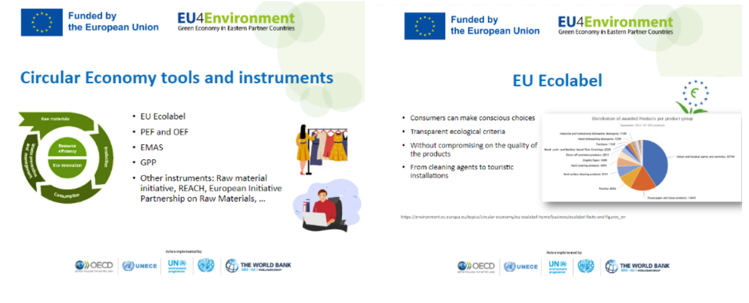
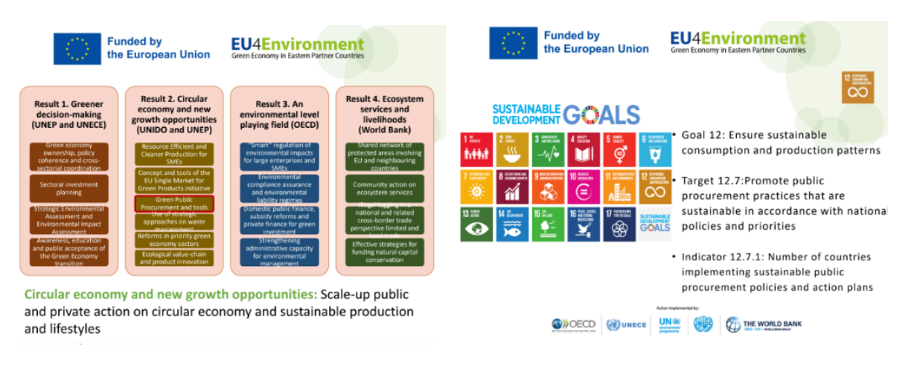
AWARENESS RAISING EVENT
THE MAIN OBJECTIVES OF THE EVENT
PRESENTATIONS
Increase awareness and understanding among relevant individuals
Showcase how the PEF methodology can be practically implemented
Outline the advantages and opportunities that the SMGP and PEF can offer to manufacturing enterprises
Facilitate discussions on the feasibility of introducing PEF pilots in Georgia

Slide 11
TRAINING ON PEF

Slide 12
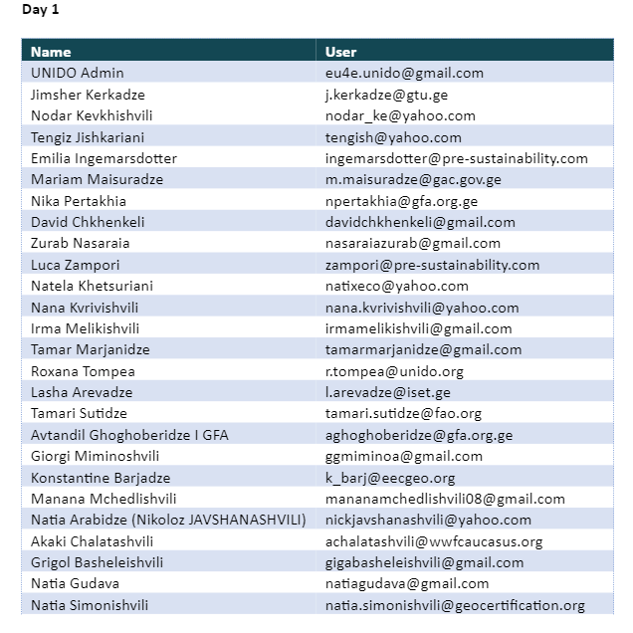
TRAININGS FOR COMPANIES AND EXPERTS
MAIN WORKS CONDUCTED DURING THE STAGE
PARTICIPANTS
Information Campaign was launched to reach stakeholders to participate in the trainings
Three day training for more then 40 interested company representatives, industry experts and other interested stakeholders were organized
EVENT PHOTOS
Initiated piloting stage
OUTCOMES FEATURED BETTER UNDERSTANDING OF THE PROCESSES RELATED TO GREEN PRODUCTS & PRINCIPLES IN GEORGIA

Slide 13
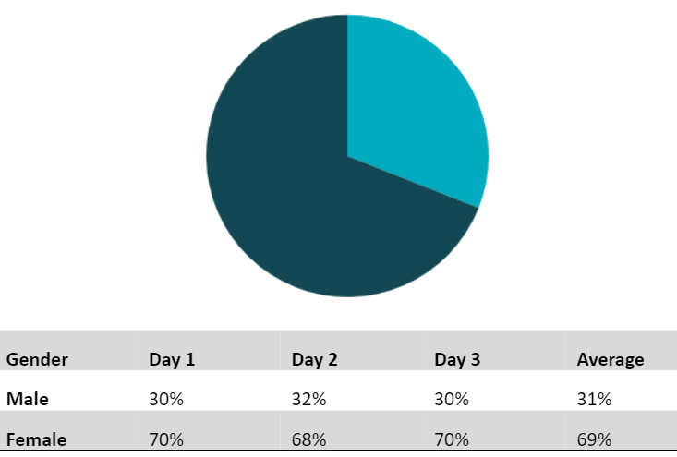
TRAINING ON PEF
3-DAY TRAININGS WERE ORGANIZED
AVERAGE GENDER DISTRIBUTION AMONG REGISTERED
DAY 1
brief welcome followed by delving into the basic understanding of Life-Cycle Assessment (LCA)
origin and overview of different ISO standards
Male
31%
Female
DAY 2
69%
identification of data needs
collection of company-specific data & default secondary data
DAY 3
exploration of hotspot analysis
topics such as data quality requirements as well as verification and reporting were discussed

Slide 14
PILOTING

Slide 15
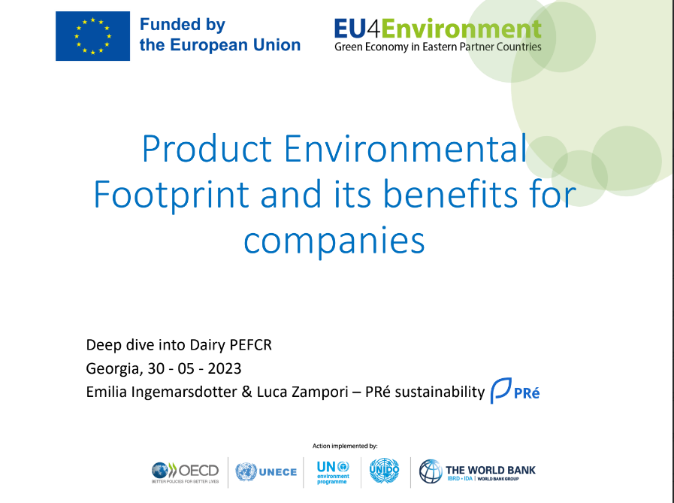
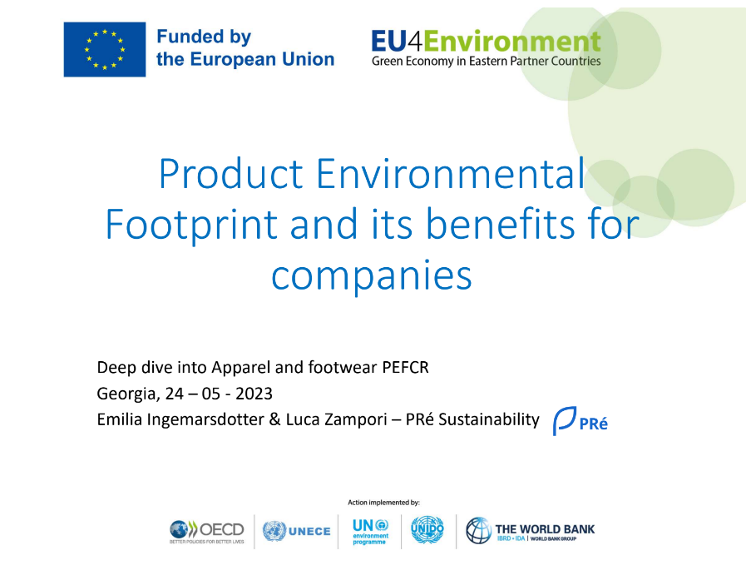
PILOTING OF PEF
MAIN WORKS CONDUCTED DURING THE STAGE
DAIRY PEFCR
APPAREL AND FOOTWEAR PEFCR
Experts were selected based on interviews
Pilot companies were selected from Apparel and Dairy industries
Additional trainings were conducted for both industries
PILOTING WILL BE FINISHED IN MID NOVEMBER AND READINESS REPORT WILL BE UPDATED BASED ON RESULTS

Slide 16
NEXT STEPS

Slide 17
FINAL REPORT
NEXT STEPS
UPDATED READINESS REPORT
Updated D1 Readiness Report with updated Roadmap
Publishable Executive Summary of the Readiness Report
PEF PILOT REPORTS
Five reports on PEF pilot application at five enterprises
CASE STUDIES
Five publishable case studies based on the lessons learned and results of PEF application
ANALYSIS REPORT
Analysis Report on issues of facilitating application of PEF methodology

Slide 18
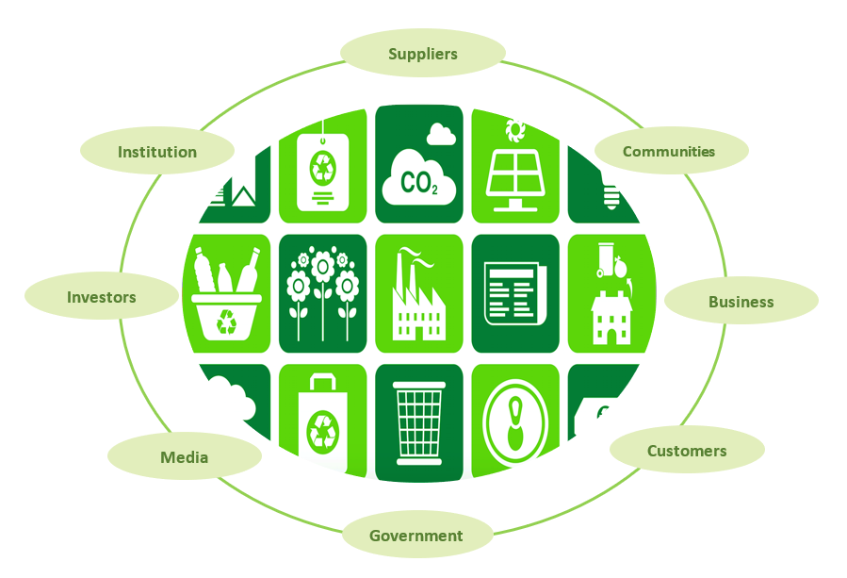
THANK YOU
COMPANY | CIVITTA International
WEBSITE | Civitta.com
PHONE | +370 670 421 16

