Slide 1
Resource Efficient and Cleaner Production implementation for Georgian SMEs: digital tools for institutionalisation
George Abulashvili
NC
7 Nov 2023
Tbilisi

Slide 2
RECP CLUBS
The RECP Club members' training helps SMEs understand the opportunities and benefits of RECP application for their businesses to address the implications of intensive use of energy, water, and materials; understand the necessity of efficient use of energy, water, and materials; learn how to build a company's energy and water profile, properly manage materials and waste and how to avoid/reduce/recycle waste. In the course of training the companies learn what is an action plan and why is it necessary? How do you create a RECP action plan? The RECP application creates significant capacities for continued improvements by identifying viable economic and environmental solutions for the companies.
One of the biggest challenges for RECP Clubs is to keep them active and to get more people involved in their activities (training, workshops, and topic-specific gatherings). Another issue is the current practice of the trainer's/speaker’s monologue, which must be replaced with a debate between the participants and the trainer/speaker.
Overcoming these challenges will ensure the RECP Club's long-term viability and provide practical results by putting theory into practice.

Slide 3
The strategy for improvement of RECP activities
Identification of the local business clusters, industry associations and share RECP Clubs’ success stories to motivate cluster members to join the RECP Network/ RECP Club Georgia. RECP Club Georgia is envisioned as network/ association of RECP Clubs’ member companies established under current and former EaP Green program in various regions, RECP Demonstration companies which are part of the current program as well participants of EaP Green program, RECP experts, manufacturing companies and professionals which will respond to invitation to join and interested in RECP.
Arrange additional RECP training/workshop for the new members to raise their awareness on such issues as resources efficiency and reduction of environmental impact and financial benefits from the implementation of RECP measures.
Establish informational platform through the creation on NIP’s Facebook page group for RECP Club Georgia to use social network actively for the invitation of new companies to join the RECP Club Georgia for providing the pre-consulting on RECP, announcements on RECP Club Georgia events and activities, announcements on available grants programs with explanations and guidelines for elaboration of the technical proposals. Get feedback from SMEs on the issues discussed and forward them to the relevant authorities if required. To support better positioning of the club member companies’ on the local market advertise them on the platform.

Slide 4
The strategy for improvement of RECP activities and network
5. Establish Annual award for the most active/ most energy efficient/ most eco friendly company. To award the companies with special prizes relavant budget should be in place. The prizes could be study tours, or participation in exhibition, etc.
6. Organize Annual exhibition titled Sustainable Manufacturing /Energy Efficienct Production/ Ecofriendly Companies, etc.
7. Organize an annual RECP Club Georgia forum for the members, and welcome new companies for participation. During the forum they will be provided with information on the RECP Club , the benefits of RECP Club through the demonstration of the national best cases and presentation of the annual report.
8. NIP being the moderator of all proposed events and keeps the facilitator’s role for the RECP Club Georgia.
1. Identification of the local business clusters, industry associations and share RECP Clubs’ success stories to motivate cluster members to join the RECP Network
2. Arrange additional RECP training/workshop for the new members to raise their awareness on such issues as resources efficiency and reduction of environmental impact and financial benefits from the implementation of RECP measures.
3. Conducting surveys to determine real requirements and specific areas of interest to businesses. Select and invite the appropriate speaker (a government official or a field expert) and organize a topic-specific meeting/workshop/trainig to share and explore the detailed information on various issues which are of interes among the Club members (see annex 1 for possible topics of the survey).
4. Arrange RECP Club Georgia members meetings on a regular basis (2-3 times per year) to discuss the most interesting issues/topics, to explore local needs, to share national good practice and approaches, to introduce new/updated legislative obligations or standards, discuss the most topical issues happening in the country affecting the business sector, etc.

Slide 5
I-GO ASSISTANT:
SUPPORTING RECP IMPLEMENTATION IN GEORGIA

Slide 6
“I-GO” Initiative
The I-GO initiative has been developed by the Green Industry Platform of the Green Growth Knowledge Partnership (GGKP), in collaboration with the Partnership for Action on Green Economy.

Slide 7
I-GO offers an integrated resource efficiency support structure for SMEs. It provides a complete toolkit that includes:
SME Support Centre - Online database including case studies, technical guides online tools, training solutions, technical assistance and financial incentives
The I-GO Assistant, the Implementation Manager tool - Online resource self-assessment and navigation tool, taking into account their location, business sector and size
Networking opportunities, promotional activities – The opportunity to share worldwide their experiences and connect with other businesses and gain expert advice through a dedicated space on the Green Forum

Slide 8
I-GO SUITE OF TOOLS
1
RECP check
Concrete recommendations
Tailored support services
SME Support Centre
2
Guidance & tools
Training & technical assistance
Financing solutions
I-GO Network
I GO Assistant
3
Implementation Manager tool
Manage audit data
Analyse opportunities
Performance tracking
SME Stakeholders

Slide 9
IT ALL STARTS WITH THE CIRCULAR ECONOMY
Consumption
& Use
Production
Recycling
RECP
(Resource Efficiency & Cleaner Production)
Resources
Waste

Slide 10
RECP SOLUTIONS
Input change
Better process control
Good housekeeping
Equipment modification
Product modification
Technology change
Production of useful by-products
On-site resuse & recycling

Slide 11
Aligning engagement with and within large corporations for effective supply chain initiatives
Enabling SMEs to easily access existing supports according to their needs
Empowering business stakeholders to develop missing supports collaboratively
HOW WORKS

Slide 12
Any SME supporting organization can become an I-GO Network Member if it:
“I-GO” Initiative
Who to become an I-GO Network Member?
Any SME supporting organization can become an I-GO Network Member if it:
Provides accessible resource efficiency knowledge and/or support services relevant to SMEs, such as NGOs, governments and international development organizations, and or;
Engages directly with SME networks, such as business associations and large companies with SME supply chains.

Slide 13
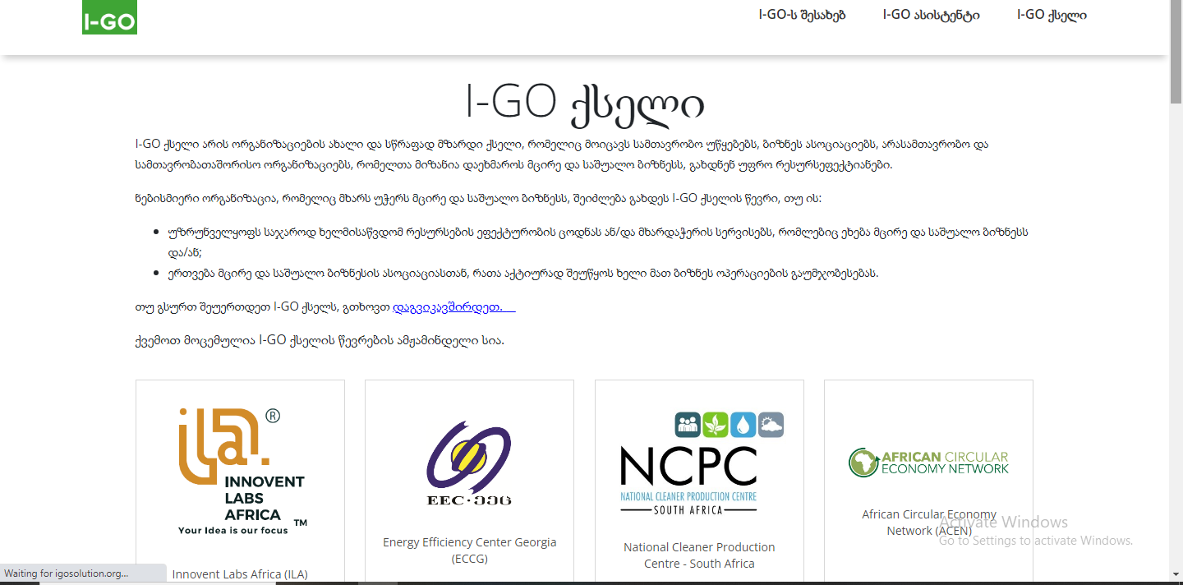
Free advice and direct support
Access the resource efficiency knowledge and support services most suited to help your company grow.
https://igosolution.org/

