Slide 1
Opportunities for the private sector in the new political context of climate change Ekaterine Mikadze National Coordinator, EU4Climate in Georgia
Tbilisi, 7th November
#EU4Climate

Slide 2
Introduction
Nationally Determined Contributions (NDCs) are national climate plans highlighting climate actions, including climate-related targets, policies and measures governments aims to implement in response to climate change and as a contribution to global climate action.
In Georgia, the NDC aims to reduce national GHG emissions to 35% below the emission levels in 1990 (excluding emissions from land use, land-use change, and forestry (LULUCF)),
As a Party/Country of the Paris Agreement, Georgia is required to update it every five years. Georgia’s “Climate and Strategy Action Plan 2020-2030” (CSAP) is a set of strategies intended to guide country and community efforts for reducing GHG emissions
In 2023, Georgia adopted Long Term Low Emission Development strategy that also considers pathways of carbon neutrality by 2050
#EU4Climate

Slide 3
Meeting the Paris Agreement by 2050
Source: IRENA
#EU4Climate

Slide 4
What is needed to reach sustainable/just/green transition?
Sustainability, digitalization, new business models, and decentralization
Renewables make up 48% of the global energy mix. Coal takes is phased out
Most automotive companies stop production of gasoline vehicles.
Robotic process automation (RPA) witnesses an increase in uptake.
Carbon neutrality targets are close to being achieved by committed organizations
Commercialization of quantum computing is on the horizon
Governance, processes, and societies become AI-driven
Full circular and hydrogen economy commercialization underway
#EU4Climate

Slide 5
Off the track
#EU4Climate
Source: IRENA

Slide 6
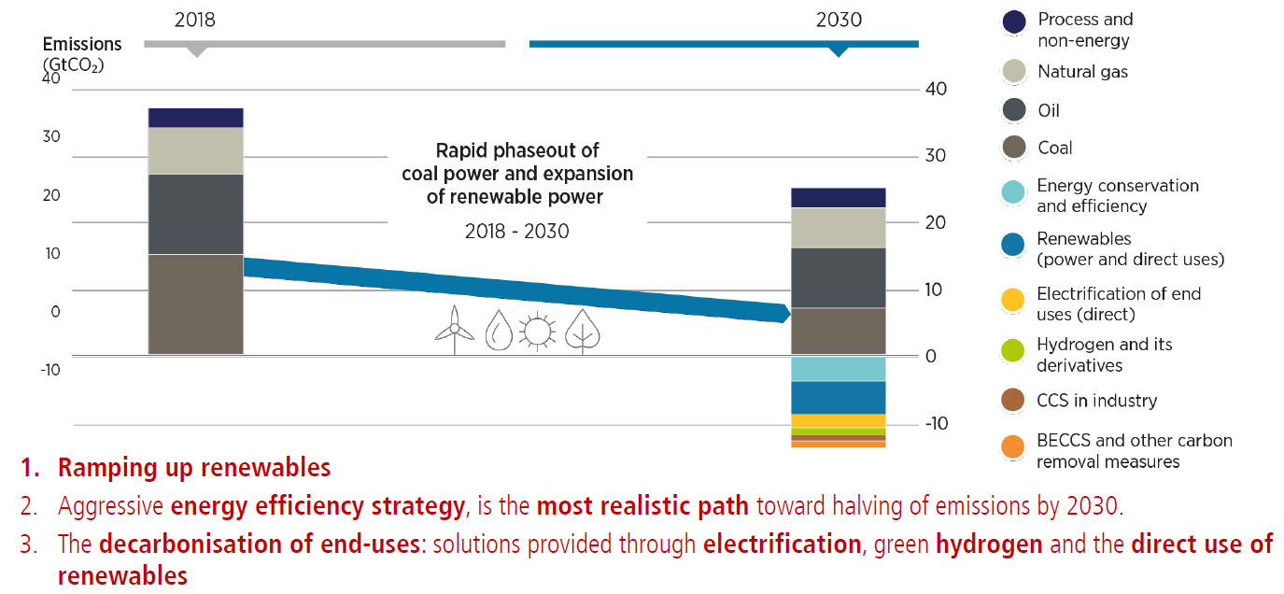
Key actions
#EU4Climate

Slide 7
Job creation
Source: IRENA
#EU4Climate

Slide 8
Recommendations for the private sector
Renewable Decentralized Energy and Mini-Grids
Energy Efficiency and Energy Management
Smart Powering & Smart Lighting
E-Mobility
Smart Farming and Precision Agriculture
Digitalization and Automation
Waste Recycling and Circular Economy Market
Ensure access to finance
Carbon Markets and Credit Mechanisms
Research and systemic innovation
#EU4Climate

Slide 9
Q&A
#EU4Climate

