Slide 3
Energy Transition for Income and Employment: Armenia, Azerbaijan, Georgia
Pilot project implemented by Energy Efficiency Centre Georgia

Slide 4
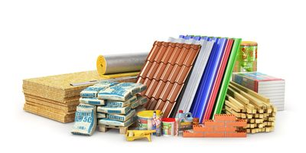
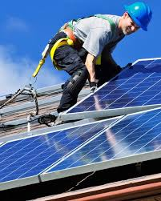
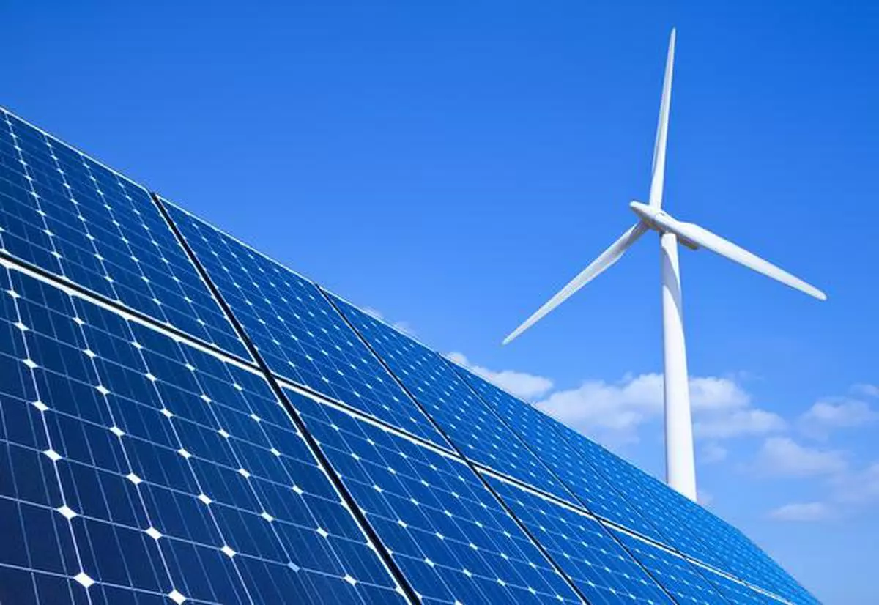
Problems identified by EECG
Shortage of professionals with the necessary skills;
Lack of relevant training, and certifications programs;
Little interest among the youth in professions for further employment in EE/RE sector;
Lack of cooperation between the private sector and vocational colleges;
Low awareness on the effectiveness of the EE/RE equipment/materials
In the frame of the pilot project EECG identified the following Demand for skilled
and certified labour to perform:
Installation of solar PV and thermal systems (Armenia)
Installation of PVC windows/doors (Georgia)
Insulation of building envelope(Azerbaijan)

Slide 5
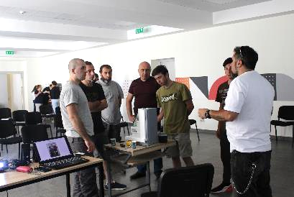
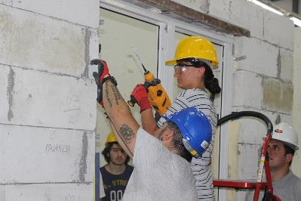
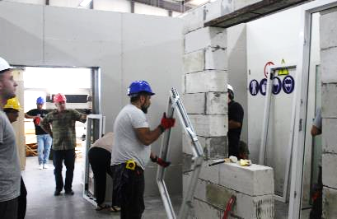
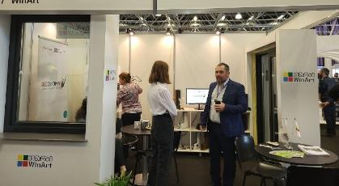
Summary of pilot in Georgia (2021 – 2022)
Construction College CONSTRUCT2
GTU
LGG
WinArt
Rehau Georgia
VET College SPECTRI
AvLux
Support provided:
To GTU in equipping laboratory for training and manual printed for solar PV installers
To “Construct 2”:
for the short-term training & certification program elaboration
In establishing a workshop for the PVC windows/doors installation
To “WinArt” to participate in the Caucasus build exhibition to present/promote quality PVC windows/doors
Some results:
Several short tutorial videos were produced on the Installation of PVC windows/doors and the Solar PVs installation
"Construct 2" has obtained the right to provide a professional training program for the PVC and aluminum doors/windows installation
Three regional TV companies covered media briefings & information for installers of solar PV systems
National TV broadcasted five Energy Efficiency related stories
82 youths have successfully completed short-term training and certification programs, among them five women

Slide 6
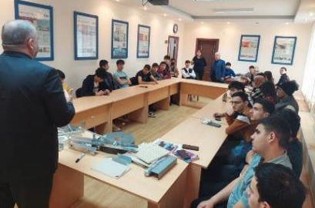
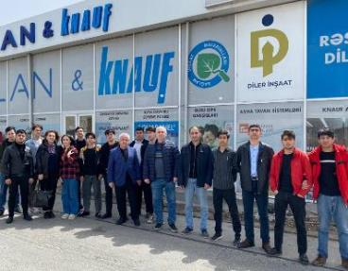
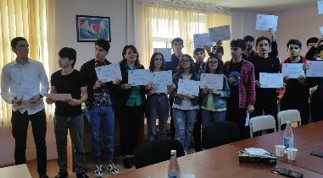
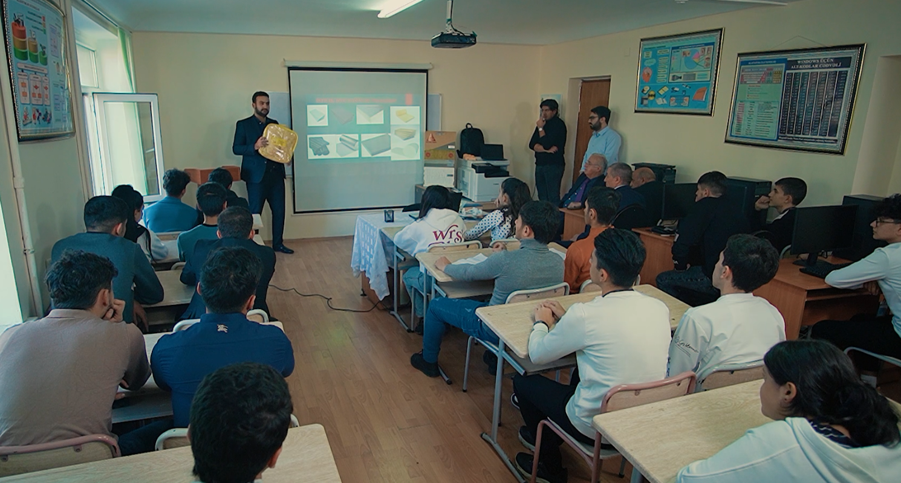
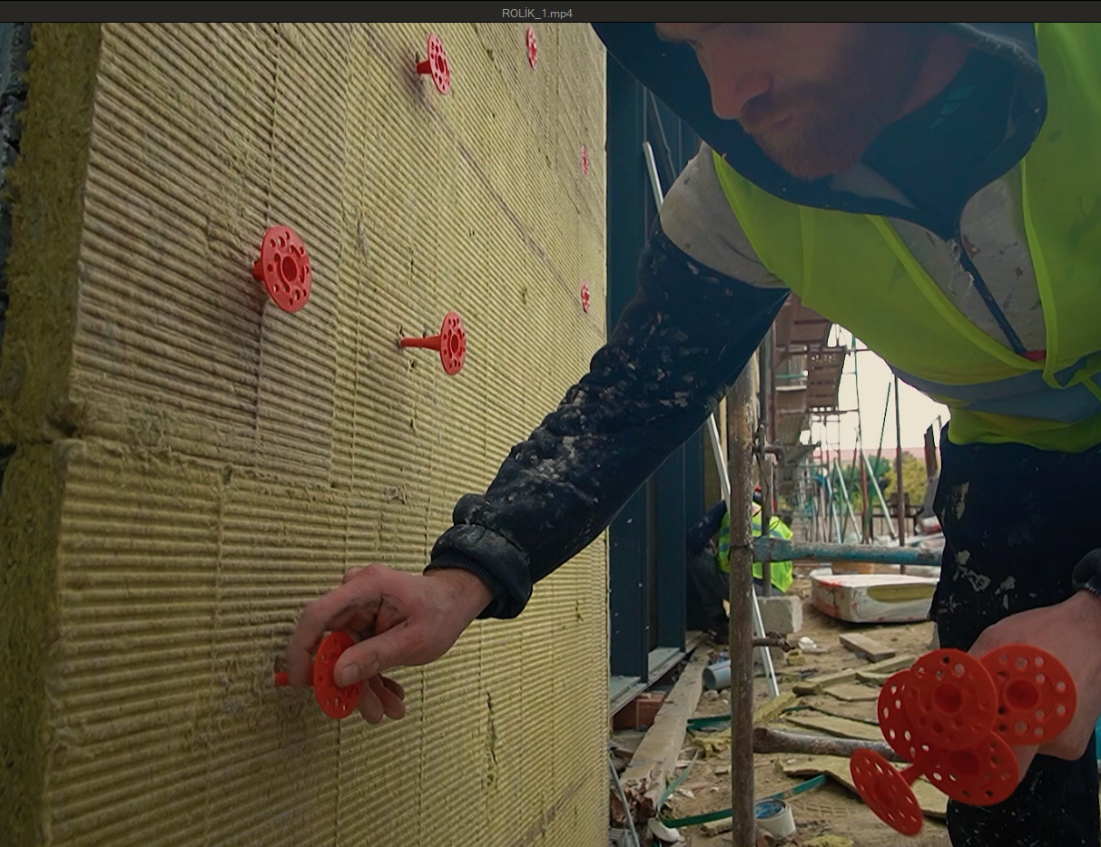
Summary of pilot in Azerbaijan (2021 – 2022)
Support provided:
To Construction College in establishing and equipping the laboratory for thermal insulation of building envelope
KNAUF Marketing Baku
Dashunu AZ
Construction College
Some results:
Short-term educational program for the installers of “Thermal insulation of the building envelope” was
approved by Construction College
The four short tutorial videos on the Thermal Insulation of Buildings were produced
Lab for Thermal Insulation of Buildings was promoted through 32 local media outlets and all social media platforms that reached 32,700 followers
87 youths (among them 11 women) have successfully completed short-term training and certification programs

Slide 7
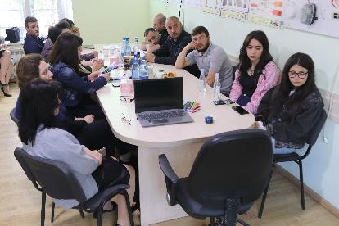
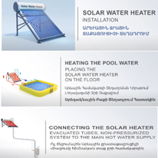
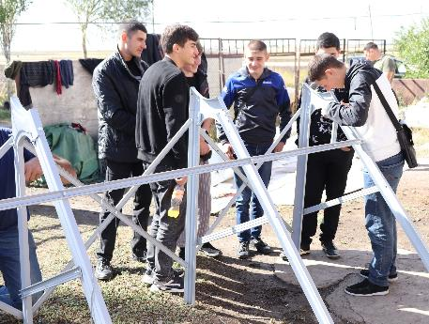
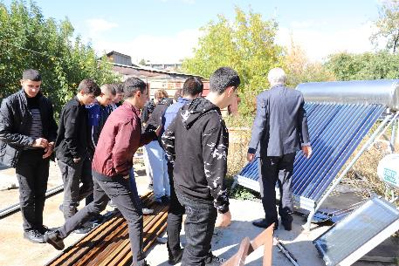
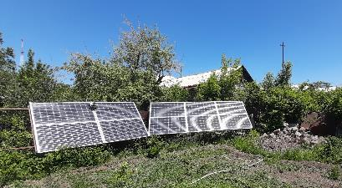
Summary of pilot in Armenia (2021 – 2022)
Rubinar
LLC
FERTI
NGO
HayArev LLC
Support provided:
To the non-formal training provider "FERTI" in establishing and equipping solar PV and thermal systems laboratories
Some results:
Short-term training program for Installers of Solar Thermal and Solar PV systems was updated
Three short tutorial videos on thermal solar systems were produced
48 youths (among them 3 women) have successfully completed short-term training and certification programs

Slide 8
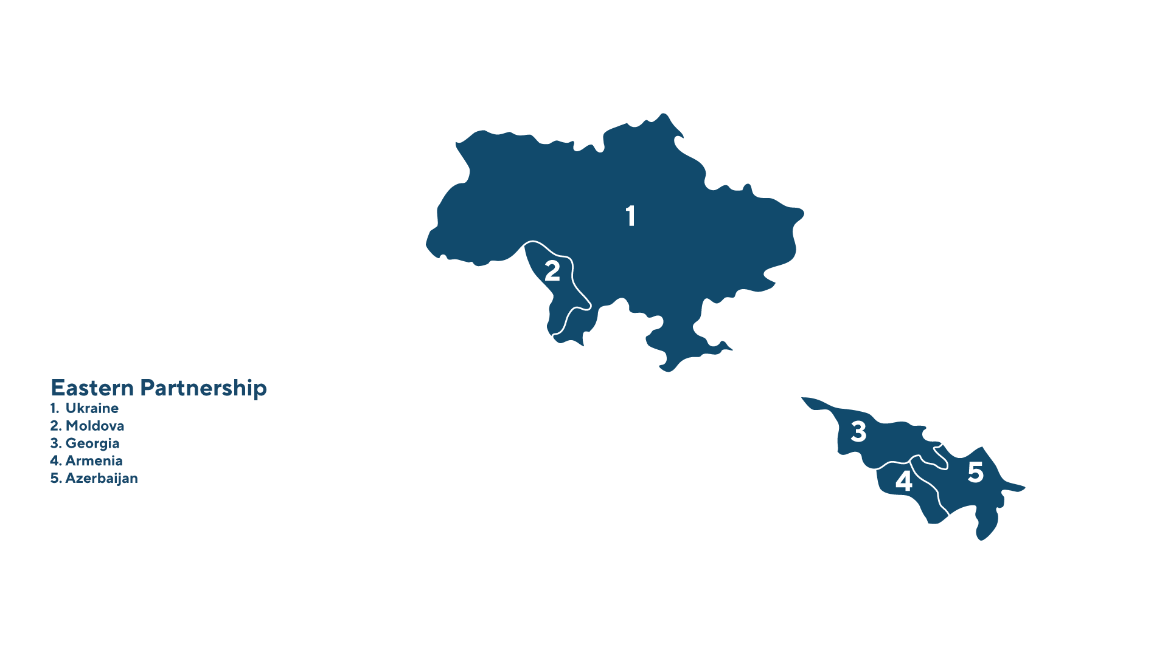
Notes:
The name of the project is “Building Skills and knowledge on energy-efficient construction and Renovation in EaP Region”.

Slide 9
INTERVENTIONS UNDER THE PROJECT
AWARENESS RAISING
EMPOWERING YOUTH AND WOMEN IN SUSTAINABLE CONSTRUCTION THROUGH:
Capacitating Intermediates
Elaboration & Dissemination of Visibility Materials
Female Influencer Engagement
SKILLS DEVELOPMENT
BUILDING SKILLS & KNOWLEDGE THROUGH:
Facilitating Linkages Between Training Providers and EE/RE Sector Relevant Companies
Market Demanded Curriculums Joint Development
Linkages Establishment for Internships
INTERMEDIATION
STRENGTHENING EE/RE MARKET CONNECTIONS & COLLABORATION THROUGH:
Career Guidance on EE/RE
Job Placement Promotion
Strengthening Regional Networks

