Slide 1

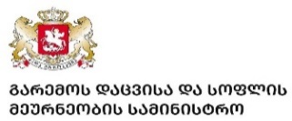


Governance Reform Fund (GRF) Project
Supporting the Government of Georgia in Enhancing Governance & Policies for a Transition to a Circular Economy
Development of the Roadmap to Circularity in Georgia
Is Circular Economy Becoming a Reality in Georgia?
Dr Dariusz Prasek
Georgian Society of Nature Explorers “Orchis”
20th October 2023

Slide 2
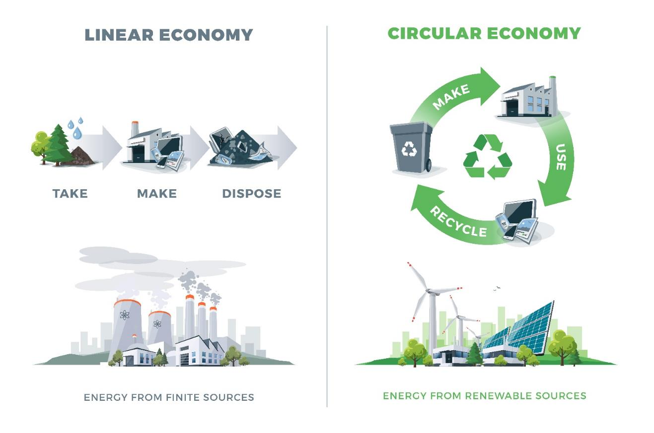
Key Steps in Transition to Circularity in Georgia

Slide 3
Circular Economy Activities in Georgia
2018 -2023
Introducing Extended Producer Responsibility (EPR) in the national Waste Management Code.
Awareness Raising Programme on the Circular Economy supported by the Government of Sweden
  8 conferences targeting policy makers, businesses, financial sector, municipalities, universities and academia, project promoters and SMEs. Special session for the Parliament of Georgia
  Two handbooks for Policy Makers and Project Promoters and for the Universities
  A series of articles and broadcasts in the media
Circularity Mapping and Development of Recommendations for the Circular Economy Strategy
Development of a pipeline of 14 investment projects.
The GoG has included the transition to a circular economy among national priorities to ensure sustainable development.

Slide 4
Key Objectives of the Circularity Mapping in Georgia (2020 – 2022)
Circular Economy in Georgia is mapped;
Appropriate national quantitative circular economy policy targets and circular ambitions are identified and established;
Sectoral circular economy opportunities are identified;
Priority sectors for circular economy initiatives and sector-specific policy options are determined;
Recommendations for the Circular Economy Roadmap and Strategy of Georgia are developed.

Slide 5
Mapping Circularity – Key Resources
Mapping process took 24 months.
13 experts working through the process and representing the highest level at various economic sectors.
Inter-ministerial group of 36 experts from various ministries and governmental agencies under the leadership of Acad..Solomon Pavliashvili - Deputy Minister at the Ministry of Environmental Protection and Agriculture of Georgia.
Consultations and interviews with industry leaders.
Review of 82 most relevant reference documents.

Slide 6
Situational Picture of Current Activities and Possibilities – the First Step
We have created an overview of the current state of the circular economy in Georgia.
We have identified ongoing circular economy activities in Georgia.
We have conducted interviews to explore the role of the stakeholders and their views on how the transition to a circular economy could be implemented in Georgia.
We have analysed Georgia’s situational picture of the current circular economy state and potential focus areas.

Slide 7
  Assessing the Current Level of Georgia’s Circularity – the Second Step
Resource productivity. The resource productivity metric was the lead indicator as recommended by the European Commission’s Resource Efficiency scoreboard.
Circular activities. A complete set of indicators including the adoption of remanufacturing and sharing was measured. As this data was not readily available, recycling rate and eco-innovation indexes were used as proxy indicators.
Waste generation by industries and consumers.
Energy and greenhouse gas emissions. Two straightforward metrics of renewable energy use and greenhouse gas emissions per GDP output were used.

Slide 8

Assess sector circular economy opportunities – the Third Step
For this step, we have engaged businesses from the focus sectors and their value chains, in order to:
Get insights and knowledge to identify the most relevant circular economy opportunities and barriers in each focus sector.
Create early alignment on a common direction for the country and the focus sectors.
Further demonstrate circular economy benefits to businesses and build capabilities.

Slide 9
  Economic Indicators Selected for Mapping Circularity in Georgia
Economic Criteria:
  Main economic criteria: Input in GDP (absolute mln GEL and %)
  Supporting economic criteria: employment indicators, annual production, annual turnover
Circularity Criteria:
  At the screening stage of the project development we have focused at the waste generation and recyclability indicators to estimate the circularity potential of the sectors.
  Resource management, product durability or/and energy saving indicators have been analyzed at the next stage of the assessment

Slide 10
Mapping Circularity in Georgia
Screening and Selection of Sectors
Criteria: Qualitative estimation of waste volumes generated by the sectors and share of recyclable waste.
Three grades were used:
  High level: high volumes of waste generation per unit of product or activity and high share of recyclable waste
  Medium level: medium volumes of waste and high or medium share of recyclables
  Low level: low volumes of waste generation and low or medium share of recyclables

Slide 11
Key Findings
Georgia is 1.3% circular — leaving a circularity gap of 98.7%.
This means that the vast majority of resources Georgia uses to satisfy its needs come from virgin sources.
The country’s economy is largely linear.
More than 315 million tonnes of resources are entering Georgian economy each year, amounting to nearly 78 tonnes per person — a figure that has continued to grow over recent years.
A significant portion of its demand is met through products imported from outside of Georgia’s borders: around 217 million tonnes of resources are extracted abroad to satisfy the country’s needs, making up just under 69% of its consumption footprint.
Georgia’s high material consumption is still deeply interlinked with emissions-intensive processes.

Slide 12

Prioritization and Clustering of the Sectors of Economy
Clustering proposed within the project is a unique contribution to the circularity assessment not implemented anywhere else. Unique contribution to the circular science.
Prioritization of industries: Identification of a small group of clearly priority industries from the entire set of economic sectors represented in the country, which have the most favourable prospects for a significant increase in the degree of circularity
Clustering of industries: splitting the entire set of economic industries represented in the country into groups of the same type according to the criteria of circularity (economic and environmental indicators, resource consumption, material and waste flows), indicators characterizing key players and the process of sector administration.

Slide 13
Prioritising and detailing the opportunities
Circular design, i.e. improvements in materials selection and product design (standardisation/ modularisation of components, purer materials flows, and design for easier disassembly).
Innovative business models, especially changing from ownership to performance-based payment models, which are instrumental in translating products designed for reuse into attractive value propositions.
Core competencies along reverse cycles and cascades, which involve establishing cost-effective, better-quality collection and treatment systems (either by producers themselves or by third parties).
Enablers for improving cross-cycle and cross-sector performance which are factors that support the required changes at a systems level and include higher transparency for materials flows, alignment of incentives, and the establishment of industry standards for better cross-chain and cross-sector collaboration. Other aspects are access to financing and risk management tools and infrastructure development.

Slide 14
Circularity Potential for Georgia
During the initial screening of sectors of Georgian economy, the team of experts selected 14 sectors, which seemed to have the highest potential for developing circular models of economy.
Overview of these sectors has demonstrated that their level of circularity is low for each separate sector. The losses and waste generation are significant in each selected sector, while the reuse of materials, recycling of wastes or recovery of materials, as well as efficient use of resources is poor.
At the same time, most of the selected sectors have significant potential for improving performance and circularity indicators. The experts have also identified priorities within each of the selected sectors.
The experts believe that through addressing the above issue, it is realistic for coming 5/10 years to increase the level of circularity from current 1.3% up to 6.6%.
For some sectors, like agribusiness, the potential is much higher and can reach 25%.

Slide 15
Sectors and Subsectors which have the Greatest Potential to Increase Circularity in Georgia
Annual crop production(agriculture)
Permanent crop production and manufacture of food products (agriculture)
Grape cultivation and wine making
Animal husbandry and manufacture of food products
Logging and wood products
Fishery and fish processing
Mining and quarrying (except oil and gas extraction)
Construction
Manufacture of basic metals
Manufacture of other goods and products
Electricity, gas, steam and air conditioning supply (Electric power generation, transmission and distribution/ Manufacture of gas; distribution of gaseous fuels through mains
Sewerage; Waste collection, treatment and disposal activities; Waste utilization, remediation activities and other waste management services
Wholesale and retail trade
Transportation and storage
Accommodation and food service activities

Slide 16
Next steps - creating a Circular Economy Roadmap
Upon completion of the circularity mapping, the Government of Georgia intends to develop a Roadmap to Circularity and adopt a Circular Economy Strategy.
The key steps would entail the following:
Create the map from Georgia’s perspective
Co-operate with other stakeholders from the start
Make sure that the Roadmap strikes the right balance between action and flexibility
Make sure that the Roadmap is flexible and relevant
Measure success, monitor development and set stages for the journey
Invest appropriate resources in the execution
Analyse national and policy implications

Slide 17
Methodology to develop Roadmap
A guide to help any country create a national circular economy Roadmap
Sitra has put together a guide based on what has been learned from Finland’s circular economy road map process.
https://www.sitra.fi/en/news/a-guide-to-help-any-country-create-a-national-circular-economy-road-map/

Slide 18

Potential Scenarios to be reviewed within the Roadmap
Experts recommended to further explore during the preparation of the Circularity Roadmap, various scenarios to shift the Georgian economy towards circularity. These scenarios could include the following:
Construct a circular built environment,
Cultivate a thriving food system,
Make manufacturing circular,
Reshape extractive industries,
Drive clean mobility forward and
Design conscious consumables.
While individual scenarios may have limited impact, all together, they can significantly increase Georgia’s circularity.

Slide 19
Practical Steps in Further Development of Circular Economy Policies and Strategy
Prepare implementation of policy packages to support 1-2 ‘quick win’ sector opportunities:
  Conduct further consultation with businesses and other stakeholders
  Conduct detailed policy cost-benefit and feasibility analysis
  Gather political support for policy intervention
Investigate which economywide policy options and potential sector packages could be implemented at a later stage
Implement selected ‘quick win’ opportunities
Track progress and adapt implementation as needed
Building on momentum of ‘quick wins’, prepare implementation of (and start implementing) 2-3 economy-wide policy options and potential sector packages
Continue implementation, track progress and adapt implementation as needed
Assess overall program success and determine next steps

Slide 20
Key Stakeholders in the preparation of the Roadmap
The Circular Economy Roadmap will be prepared in close cooperation and coordination with the GoG and other key stakeholders, especially MEPA and MoESD to ensure collaborative and participatory process.
It is expected that the Inter-Ministerial Coordination Board established by the GoG for the Circular Economy mapping will continue their work and actively engage in the development of the Roadmap to make this document as useful for the GoG as possible.
On-going consultations with key stakeholders will be ensured throughout the entire project time.
Other stakeholders such are relevant ministries, various governmental agencies, SMEs and business associations, financial sector, etc. will be consulted as needed to elaborate on issues of concern.

Slide 21

Roadmap based on the so-called
“Circular Triangle”
Circular Economy (business models)
Circular Change (government policies)
Circular Culture (citizens)

Slide 22
Thank you!
Contact Details:
Dr. Dariusz Prasek
deprasek@gmail.com
orchisge@yahoo.com

Slide 23
Governance Reform Fund (GRF) Project
Supporting the Government of Georgia in Enhancing Governance & Policies for
a Transition to a Circular Economy

