Slide 1
Greener business in Georgia: The balance sheet after ten years cooperation
7/10/2023
Dr. Johannes Fresner
UNIDO Senior technical advisor

Slide 2
The elements of the „balance sheet“
Stocktaking: Demonstration of resource efficiency in Georgia
Next steps to circular economy
The way forward

Slide 3
The circular economy is a concept and economic model that aims to reduce waste and maximize the use of resources by keeping products, materials, and resources in circulation for as long as possible. It is a departure from the traditional linear economy, which follows a "take-make-dispose" pattern. In a circular economy, products and materials are reused, refurbished, remanufactured, and recycled to extend their lifespan and minimize the generation of waste.
Key principles and components of a circular economy include:
Design for Sustainability: Products are designed with durability and recyclability in mind. The goal is to create products that can be easily disassembled, repaired, and recycled.
Resource Efficiency: Maximizing the use of resources by reducing waste and ensuring that materials are continually reused or recycled. This minimizes the extraction of new resources.
Product Life Extension: Extending the life of products through repair, maintenance, and refurbishment. This reduces the need for new products and minimizes waste.
Sharing and Collaborative Consumption: Encouraging the sharing and rental of products to reduce individual ownership and promote efficient resource use.
Materials Recycling: Recycling and repurposing materials to create new products, thereby reducing the need for virgin resources.
Waste Reduction: Minimizing waste generation through better practices and processes, with the ultimate goal of achieving zero waste.
Reverse Logistics: Establishing efficient systems for collecting and returning products at the end of their life cycles for refurbishment or recycling.
The circular economy promotes environmental sustainability, economic growth, and the conservation of natural resources. It is seen as a response to the challenges posed by a linear economy, such as resource scarcity, environmental degradation, and the growing problem of waste disposal. Additionally, it encourages innovation in product design, manufacturing processes, and business models.
Governments, businesses, and organizations around the world are increasingly adopting circular economy principles to address these challenges and create a more sustainable and resource-efficient future.

Slide 4
The goal: Circular Economy (UNIDO vision)
RECP options
Notes:
Österreich 19t pro Person und Jahr, 9,7% according to circularity report, 30% of all input is recycled, 58% of municipial waste
Austria has a high resource consumption in European comparison. The material footprint (MF) in 2017 was around 290 million tonnes (Mt) and was about 33 tonnes per capita and the domestic material consumption (DMC) was 19 tonnes per capita in 2018
Dr Prasek in a minute will present the numbers from Georgia

Slide 5
Examples for resource efficient production
100 m of bare steam pipe with a diameter of 150 mm carrying saturated steam at 8 bar would waste 25 000 litres furnace oil per year, costing 12 000 EUR or more
Compressed air leaking from a 1 mm hole at a pressure of 7 bars means a constant power loss equivalent to 0.5 kW costing around 250 EUR in 4 000 hours
If you leave water running from a hose with 12 mm outlet diameter, the loss will be 2.5 m³ per hour: Use a bucket and a wristwatch to characterise such losses!
Regarding materials: one kg of hot rolled steel sheet will cost you more than 1 EUR; for one kg of scrap you probably will get a compensation of 0.3 EUR: so, every kg steel you turn into scrap is a loss for your enterprise!

Slide 6
RECP practises
Management
Labor
Technology
Products
Materials
Production process
Waste
Source: Vectorstock
Notes:
RECP focuses on the company level. Five common generic techniques for implementing RECP include:
• Management and labor: Improved housekeeping practices
• Waste reduction
• Raw material substitution
• New technology
• New product design

Slide 7
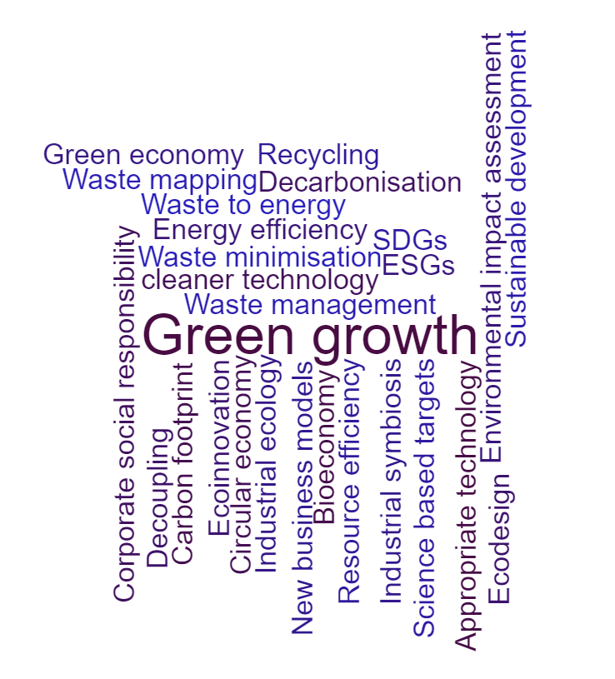
Terms and definitions
Congruent concepts on company level
Goal: Green industry and decoupling GDP growth from resource consumption and waste generation
Notes:
https://www.wortwolken.com/

Slide 8
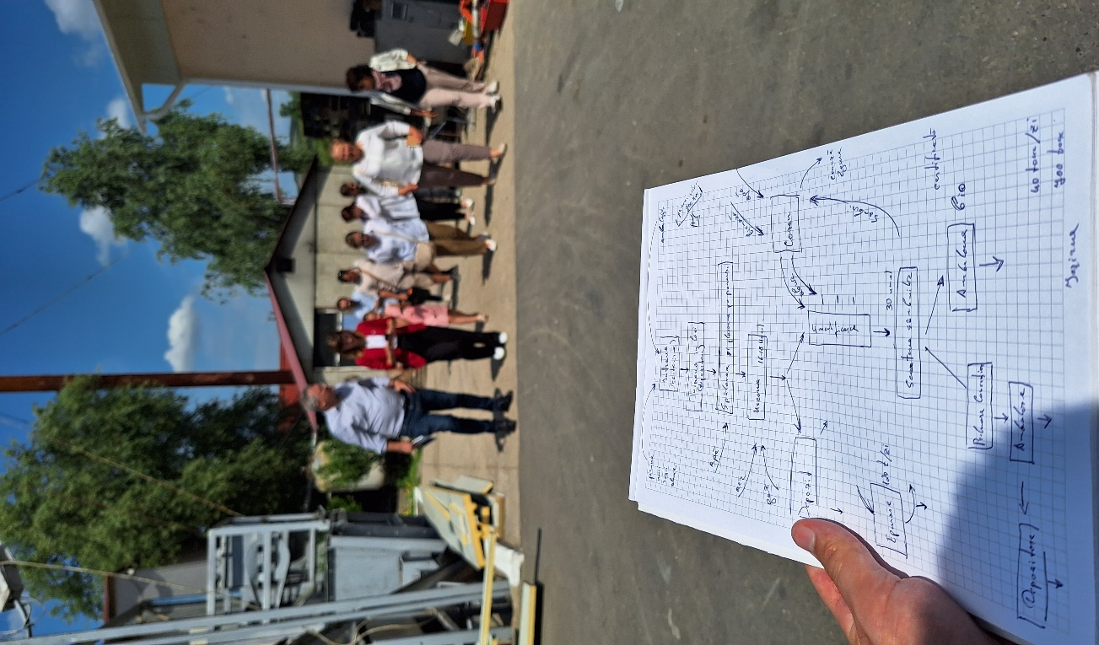
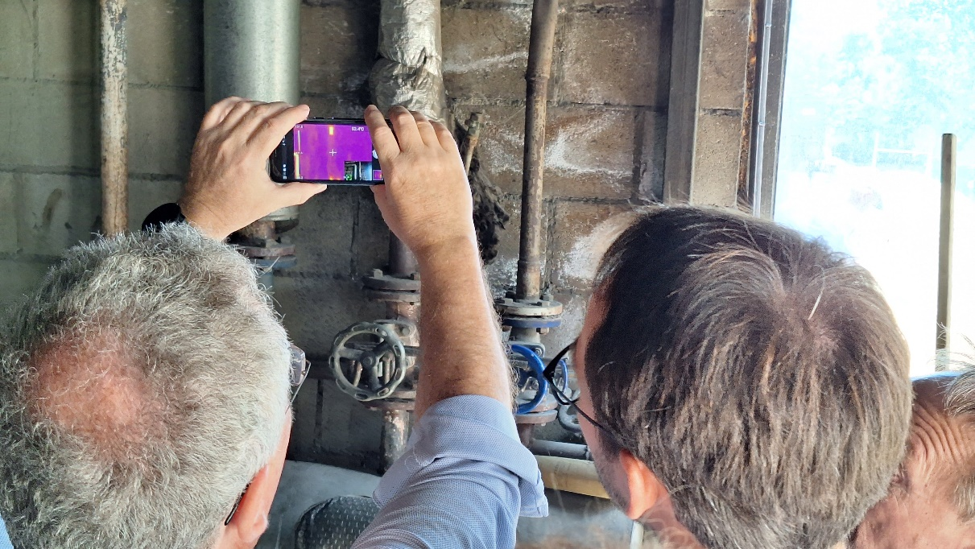
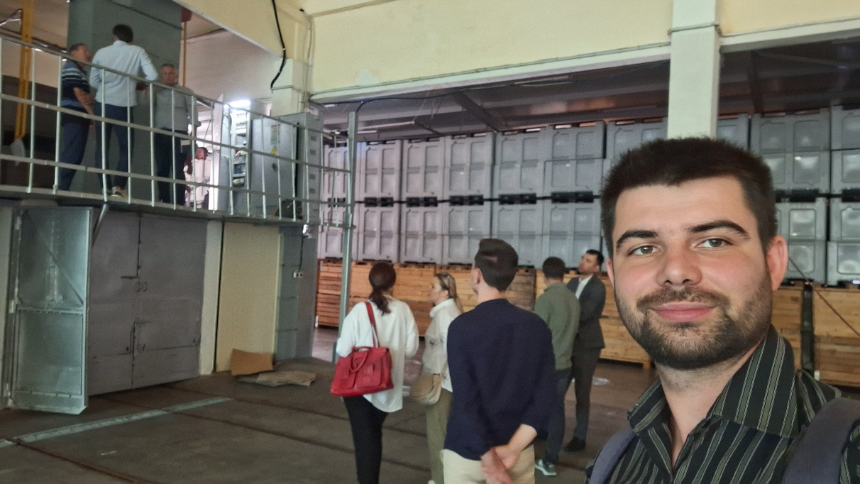
RECP in practical terms

Slide 9
Documented results

Slide 10
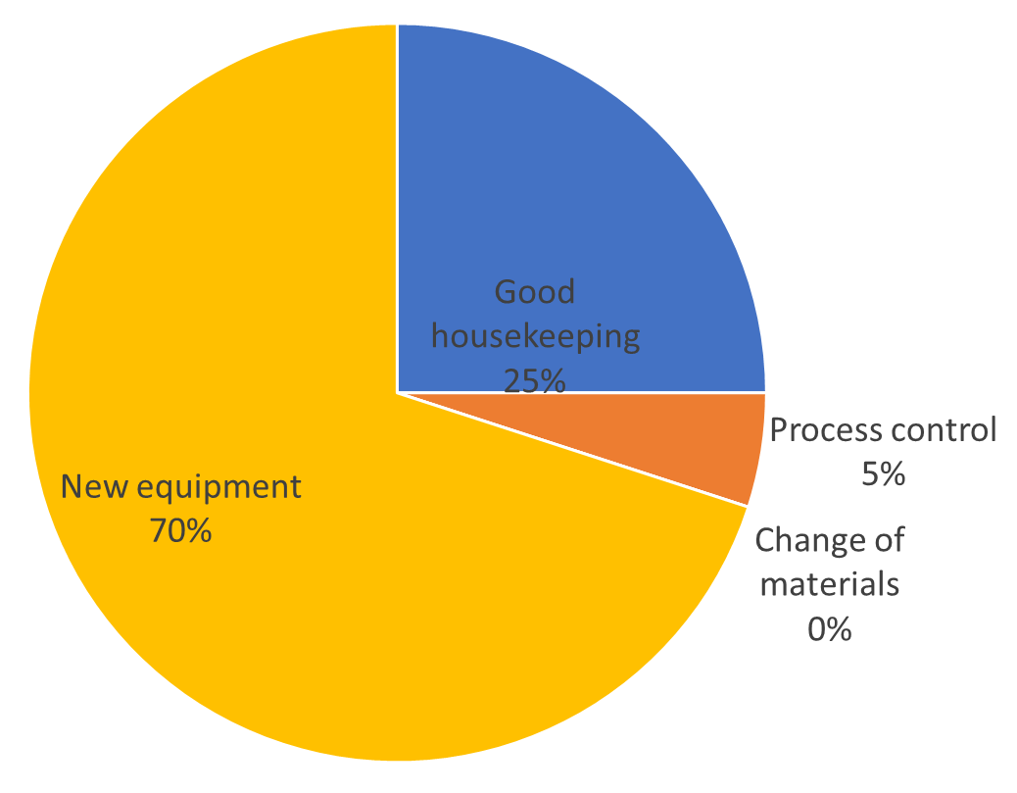
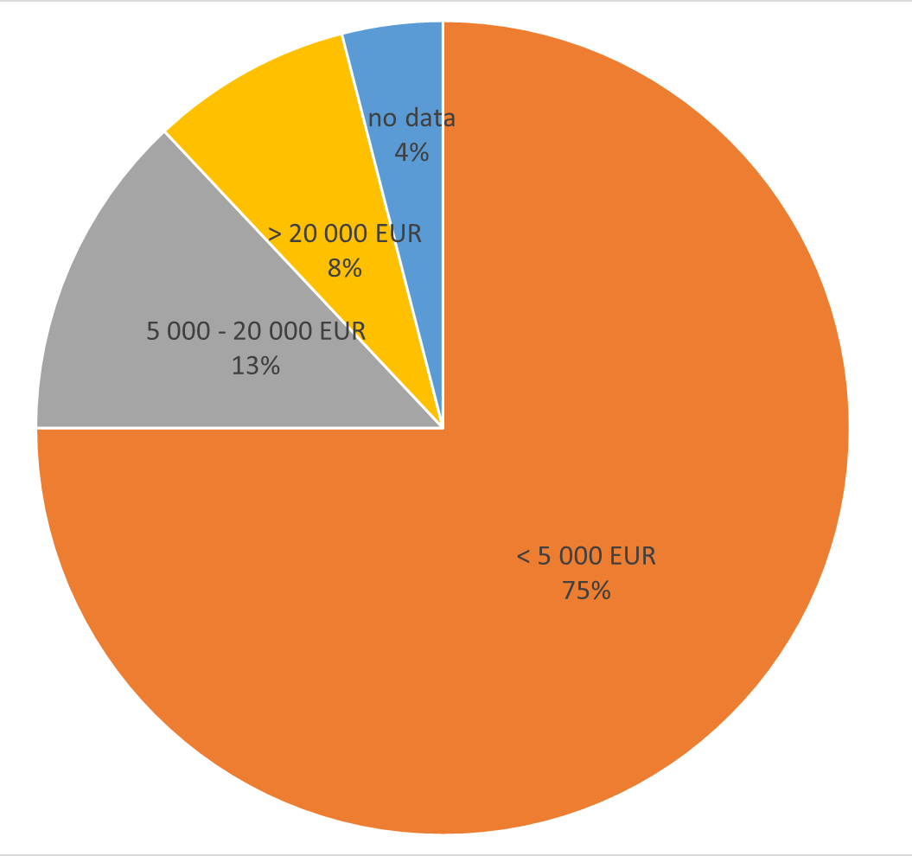
Results from 70 companies: 4,6 GWh electricity, 4,7 GWh natural gas, 3 300 t waste reduction, 920 000 EUR savings
Notes:
In EaP Green 80% implementation!

Slide 11
The RECP balance sheet in Georgia
EaPGreen 2015
Monitoring
EU4nvironment 2021
Assessment, RECP clubs
Industry 4.0, CE
Assessments, RECP clubs
Monitoring
More than 10 000 enterprises
Notes:
Number in assessments, number in clubs in EaPGreen (2018): 18 Demo companies, 32 in clubs
Conclusions The project was very relevant according with MoEconomy, MoEnvironment (“rate top 5 out of 65 projects currently being implemented”), as it contributes to reaching the commitments of the government in terms of energy efficiency, greening the economy, emission reduction (Intended Nationally Determined Contribution) etc The Georgia Employers Association34 and companies also find the project very relevant. Reportedly this was the first time RECP concepts were disseminated in Georgia. The project reach the intended goals: generated awareness through conferences and fora, involved 50 companies, trained 18 experts, 18 demonstration companies were assessed, 35 companies participated in the clubs and developed an RECP action plan. Many companies implemented part of the measures (particularly the ones with low cost) and other companies implemented RECP measures different from the ones proposed but because of the discussion and way of thinking brought by the project The project did an experiment with a larger company but general agreement (including from the company) is that RECP method should be addressed to SME It has been important to have a steering committee at national level and the regional conferences were very important moments for exchange of experiences The project had some administrative-financial burden for the hosting entity. UNIDO HQ can improve some contractual procedures (e.g. extension of mandate) and provide indications for reporting. The sustainability of the actions of the project is low The Green Economy Centre has potential if it establishes adequate partnerships and creates good reputation; academia expressed interest to have trainings or courses on RECP, business association expressed interest to provide services to their members. Sustainability All activities of RECP stopped when project finished. Green economy Centre was created as an NGO (by the project manager and some of the experts), but has no budget and no activity. Unplanned Results Some of the materials produced by the project have reached university students. Some experts are university professors and took materials to students, and are using the primer examples and guide books in class. One of the Commitments Georgia made at the Batumi Initiative on Green Economy (BIG-E)35 is “Promoting Greening SMEs and Resource Efficient Production and Consumption in Georgia”. This commitment has been promoted by the project.
Recommendations  The Green Economy Centre should seek partnerships with business associations, industry associations, trade unions, etc, to reach out to more companies; and partnership with universities to reach out to students.  Stronger technical expertise from UNIDO particularly in the definition of the final solutions (at the advanced assessments) is necessary. An experienced international specialist can point out solutions unknown to Georgian specialists.  Future project should increase links with legislation (use examples, create awareness of legislation changes that are to happen, etc).  It could be interesting to include some items of environmental management system, no need for the whole ISO14001  Future projects should involve more the banks (particularly those adhering to IFC rules - mainly their compliance department).  Future project should provide training to business/industry association’s staff involved in training/coaching companies. Future project should also think about training of environmental inspectors.  Future project should think about co-financing of larger interventions as pilots; and have a fund for low cost/high impact measures for demonstration.  Whenever there is expertise in the plant, the solutions should be thought together with the plant technicians.  The concept of clubs should be extended to experts, so they can continue communicating with each other  Improve knowledge sharing mechanism between experts at national level, and between EaP countries, via internet  Produce videos with technical solutions implemented.  Produce recordings of the trainings, in particular of webinars  Better support from UNIDO in terms of publicity-communication for the project at national and international level - ideas what materials to produced  Improved backstopping from UNIDO for seeking donor’s support to the Green Economy Centre Lessons learned - Ministries and business associations are keen on the continuation of the project - it was the only component of EaP Green with concrete outputs in the field. (Letters from Ministry to UNIDO at the final report) - Stakeholders praise the fact that the UNIDO component had national representatives (the Project Manager), and recommend other components to also have representatives - Several companies showed interest to be linked or to be provided with contact of companies that in other EU countries perform the same processes, in order to share experiences. - The role of the ministries regarding the RECP component was to receive information once or twice per year, to participate in some events when invited to provide prestige, help to organize list of participants, and to support when needed. The lack of coordination between the different components of EaP Green was in part due to this passive attitude. - There is a need to think about financial support (that would function as incentive) for implementation of solutions (e.g. see Green Credit Trust Fund, Viet Nam). For example work with banks for establishing specific credit lines (e.g. extend ProCredit Eco-loan to SMEs), lower bank interest (through guaranties?), co-financing of solutions, a revolving fund, financing of pilots, leasing equipment, etc - otherwise companies will not invest. - Conditions should be created for the clubs to continue to exist.
Co-financing itself may not be sufficient, as there is a capital of trust that needs to be built with the companies. Future project should last longer time, working with companies and devising the solutions together with the companies. Several companies state that they know their problems and priorities, and that the project should be more focused on solutions than on assessing the problems - In many companies the top management is not the owner of the plant. If a project has a payback of several years the management may not be interested to implement as they don’t know if they will stay in post. It is important that the project tries to involve the owners of the plants, when relevant. - Many Industrial SMEs run old equipment and technicians who know operation and maintenance of the equipment will soon retire; there is a need for modernization of equipment. - Several companies state that they know their problems and priorities, and that the project should be more focused on solutions than on assessing the problems - Reportedly project was mostly focused on energy efficiency and it would be better to be broader in scope - other areas as strong as EE. - Companies were expecting to receive some funds do implement measures - the project did mention that would help to find sources of funding. - Companies prefer to integrate the RECP investment in larger company development loans - Providing certificates of attendance to companies is a good idea. Companies like it. It can be suggested to have two certificates, one of attendance, but a more valuable one of implementation. - Regional meetings are very important as a means for countries to share their experiences and learn from each other - Webinars in the way they were imparted are not so effective. With limited interaction, people being at their office easily get distracted and start doing other things. - Translations of the technical materials (pocket guides) need to be revised by technicians in order to avoid errors and provide credibility.
RT8

Slide 12
„RECP/CE readiness index“
using Germany, South Africa, and China as reference

Slide 13
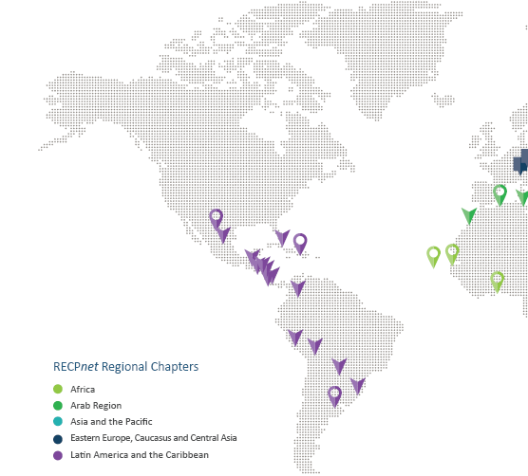
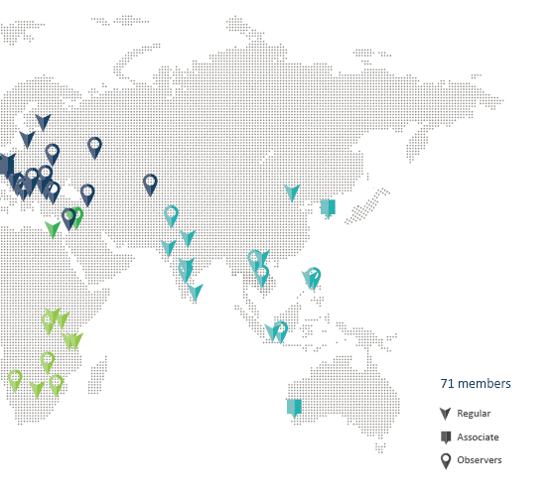
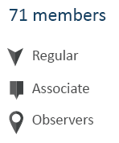
Global Network (RECPnet)
Centres of expertise working with industry to scale up and mainstream RECP
Powerful network: knowledge, experience, technology transfer
Over 70 members in more than 60 countries

Slide 14
UNIDO Circular Economy vision
RECP options

Slide 15
Step by step towards UNIDO´s Circular Economy vision
RECP –Environmental management

Slide 16
Step by step towards UNIDO´s Circular Economy vision
Circular economy
Materials
Improved quality of raw material
Energy efficiency:
LEDs
Heat recovery
Preheating
Condensate return
Insulation
Upgrade of motors and equipment
Towards zero carbon:
Biogas
Biofuel
Biowaste as fuel
Photovoltaic panels
Notes:
Out of the reports of the last assessments

Slide 17
Concept: Way to do business
Improved efficiency will not solve the problem of finite resources – a full system change is needed.
McDonough & Braungart (2002) − two types of material flows in a circular economy:
Biological (‘consumable’) Materials – Re-enter the biosphere to build natural capital;
Technical (‘durable’) Materials – High quality, high added-value. Designed to circulate and not enter biosphere.
Functional service economy:
Closed-loop systems advocate a ‘functional service economy’ in which manufacturers and retailers shift from selling products to selling services.
Products are designed for a cycle of disassembly and re-use.
Companies maintain ownership of products and act as a service provider.

Slide 18
Recommendations for circular development
Systemic mindset. Avoid temptation to think only of better waste management. Think of “circular economy systems”.
Creative mindset. Out-of-the- box thinking, cooperation, persistence.
Data. Accelerate development of waste data and reporting.
Life cycle and value chain. Promotion of life cycle thinking and provision of tools.
Digitalisation. Records, accessibility of data, tools. Leads to better analysis and better management.
Collaboration. Importance of collaboration and symbioses between industry.
Continuous process. Continuous improvement and application of the PDCA-cycle.
Procurement. Green procurement can help develop markets for circular solutions.
Regulation. Support reuse and recycling, e.g. end of waste to clarify how wastes cease to be “wastes”.
Fiscal tools. Discourage disposal (e.g. landfill tax) and incentivize reuse and recycling (e.g. tax breaks).

Slide 19
The way forward
Continuous support of enterprises
Facilitate access to finance
Adapt to the characteristics of micro, small, medium and large enterprises
Continue experts training with specialised trainings: environmental management, circular materials, product design, circular business models, cooperation
Support institutionalisation, nurture ecosystem, put together puzzle

Slide 20
Thank you very much for your attention!
Გმადლობთ ყურადღებისთვის!

